Slide 1
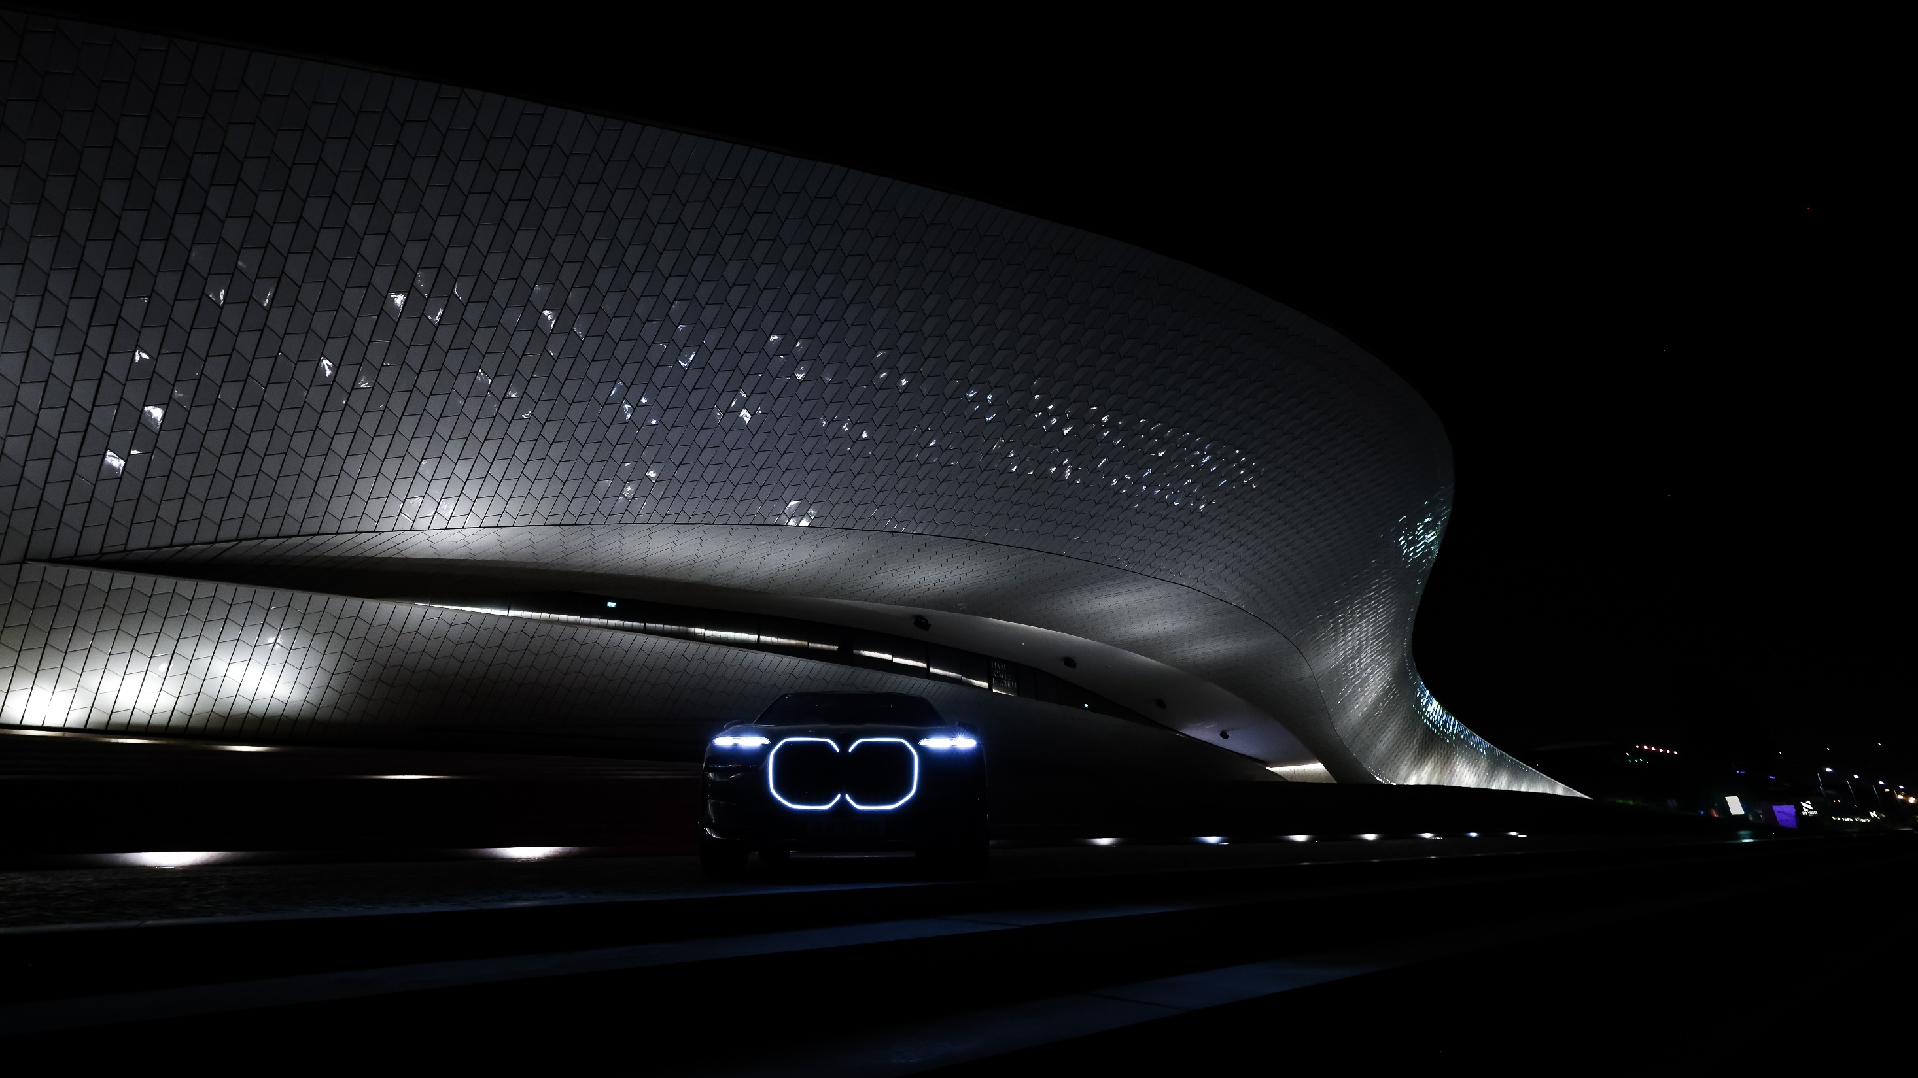
2024
Bmw group ROMANIA
CONFERINŢA ANUALĂ DE PRESĂ

Slide 2

AGENDA
BMW Group Strategic Development and Global Sales.
BMW Group in Romania,
Then and Now.
Outlook 2025.
Oliver Rademacher
Managing Director BMW Group Romania

Slide 3
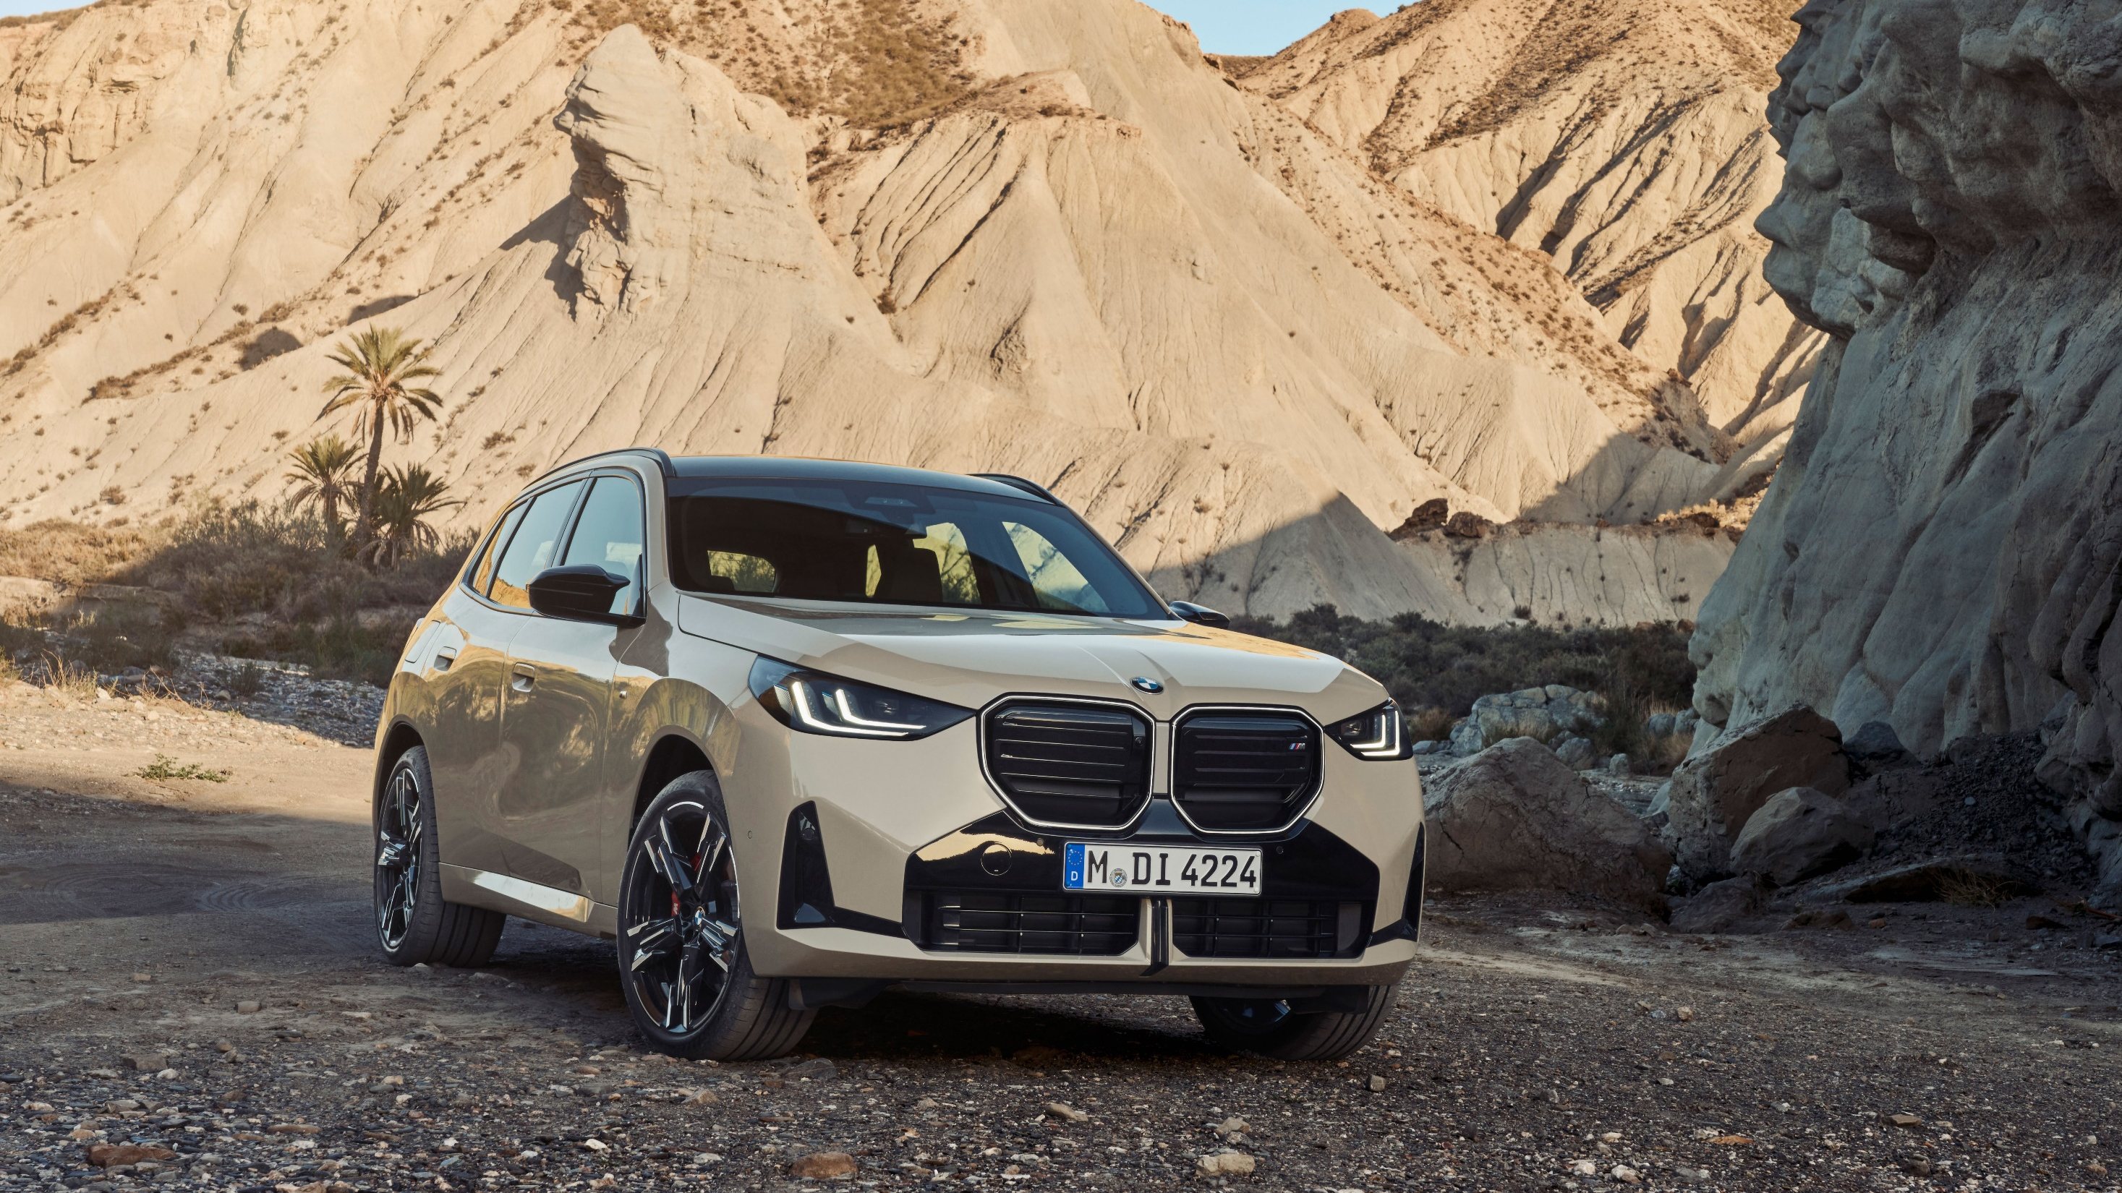


BMW GROUP GLOBAL SALES
2024

Slide 4




BMW GROUP GLOBAL RESULTS
2 200 177
-2.3%
244 915
-17.1%
210 408
+0.6%
BMW Group
2 450 804
- 4.0%
5 712
-5.3%
Notes:
Global sales:
BMW #1 in premium.
BMW Group stable in difficult market enviroment.

Slide 5
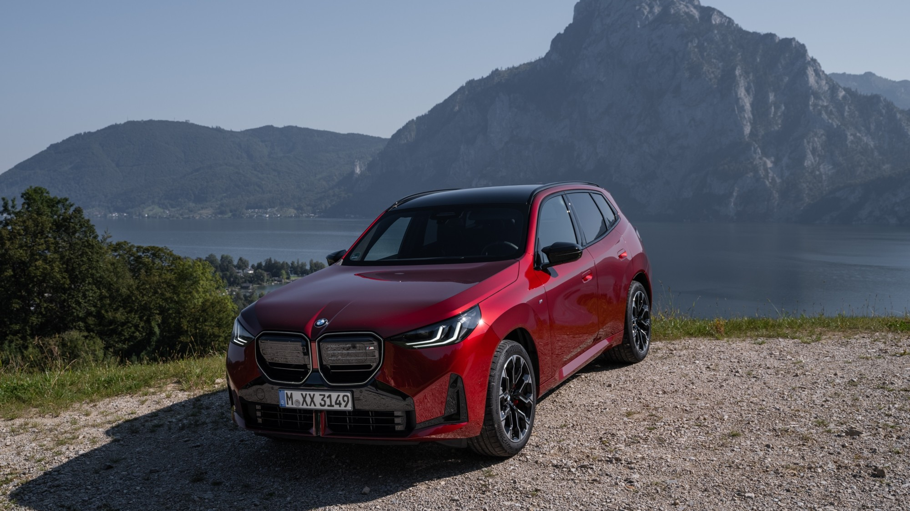
BMW GLOBAL RESULTS
Notes:
BMW BEV growth against global trend to strengthen global sales performance.

Slide 6
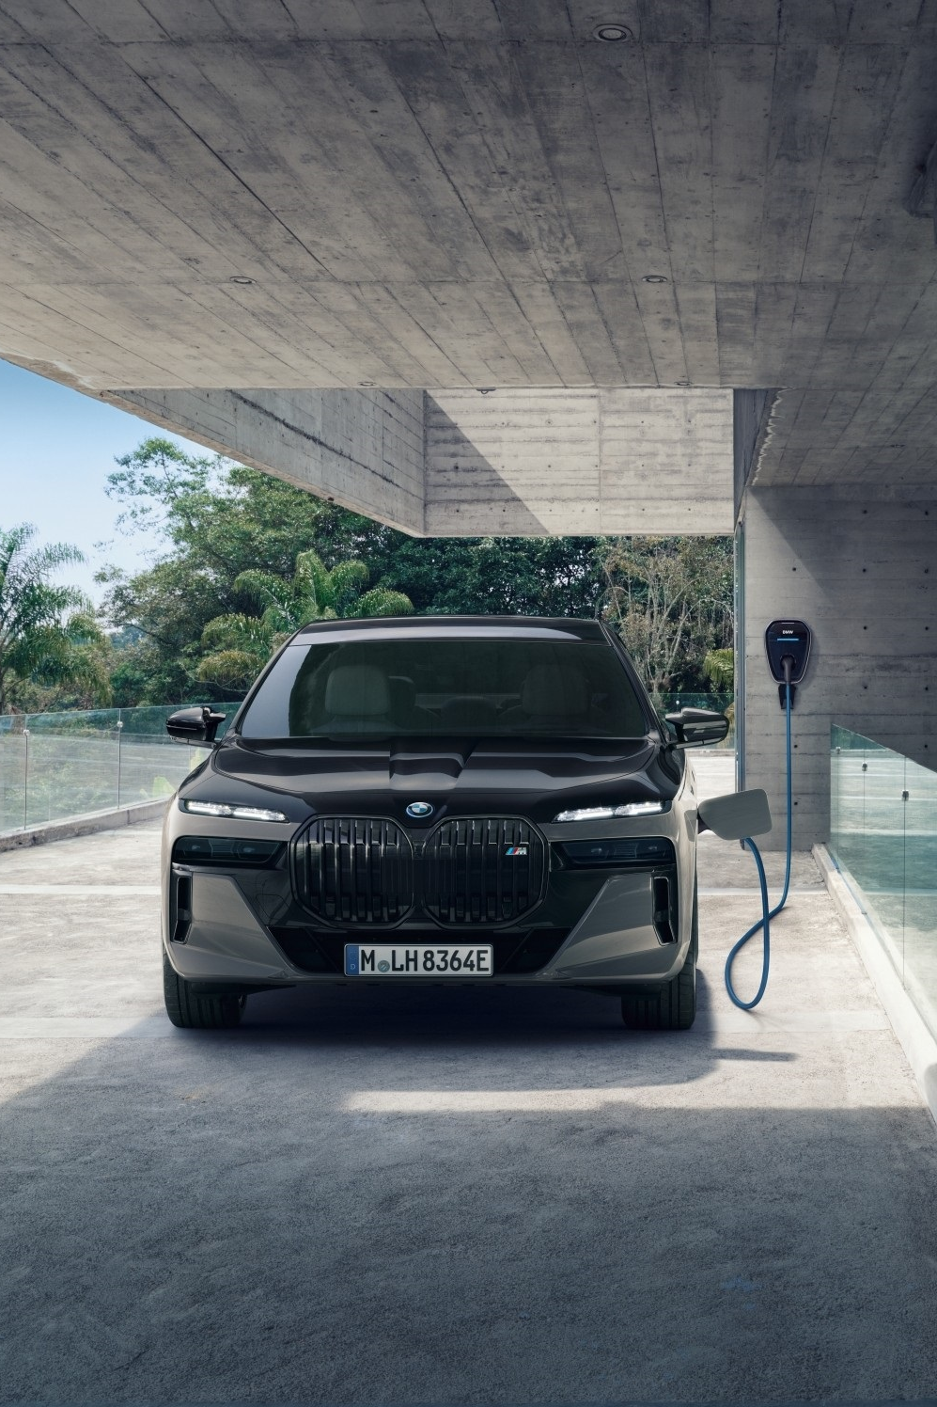
BMW GLOBAL RESULTS
2 200 177 units
Number one in premium segment.
Growth, stability in all sales regions except China. Targets achieved in a challenging market environment.
Successful model launches X3, 1 Series, BMW M5.
+11.6%, 368 523 BEV sales have strenghten
BMW global performance.
Notes:
Complete model range transformation, supported by electrification and new technologies, such as an UX with first OLED round screen in automotive industry.

Slide 7
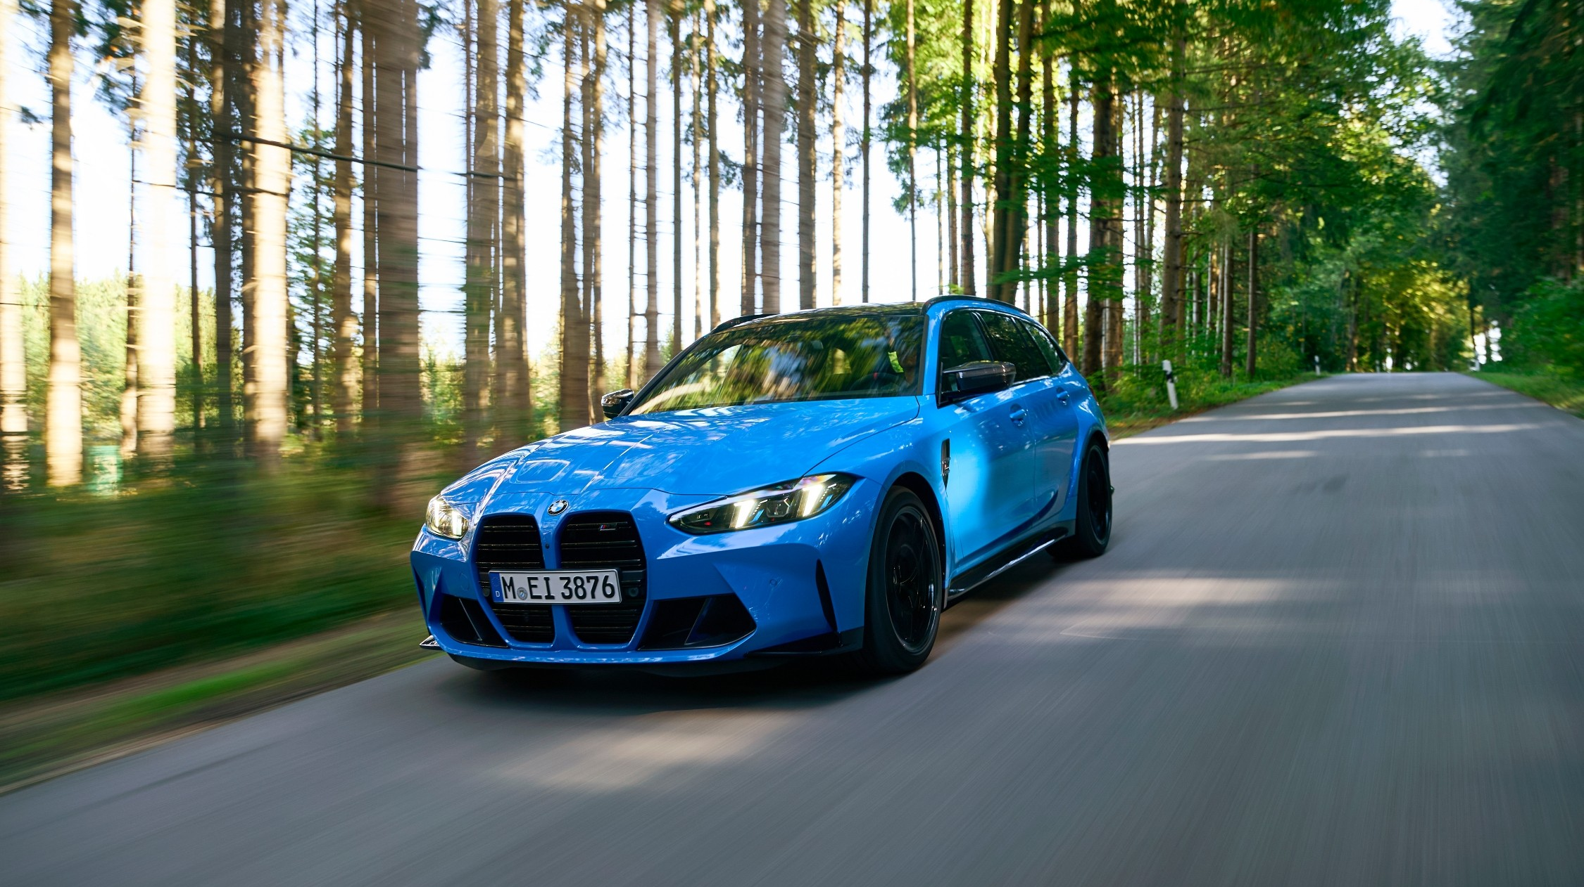

BMW M GLOBAL SALES
Notes:
BMW i4 M50 remains the best-selling BMW M model in 2024 – an excellent example of the group’s strategic transformation.
First BMW M high performance PHEV models – XM and now BMW M5.
BMW M high performance touring models, with BMW M3 and M5.

Slide 8
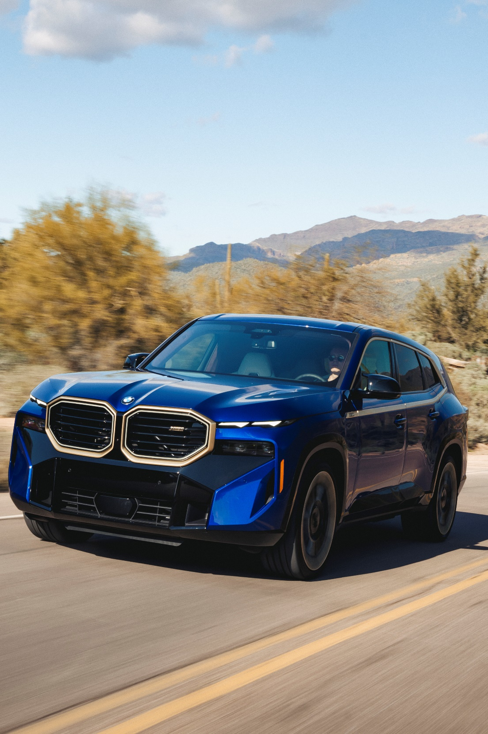
BMW M GLOBAL SALES
+2.1%
206 582
high performance
and performance models
Record sales in the 50 years
company history.
Best seller BMW i4 M50 for the 3rd year running.
Record growth for:
BMW M2 +64%
BMW M3 Touring +57%
BMW XM +17%
Notes:
Complete model range transformation, supported by electrification and new technologies, such as an UX with first OLED round screen in automotive industry.

Slide 9
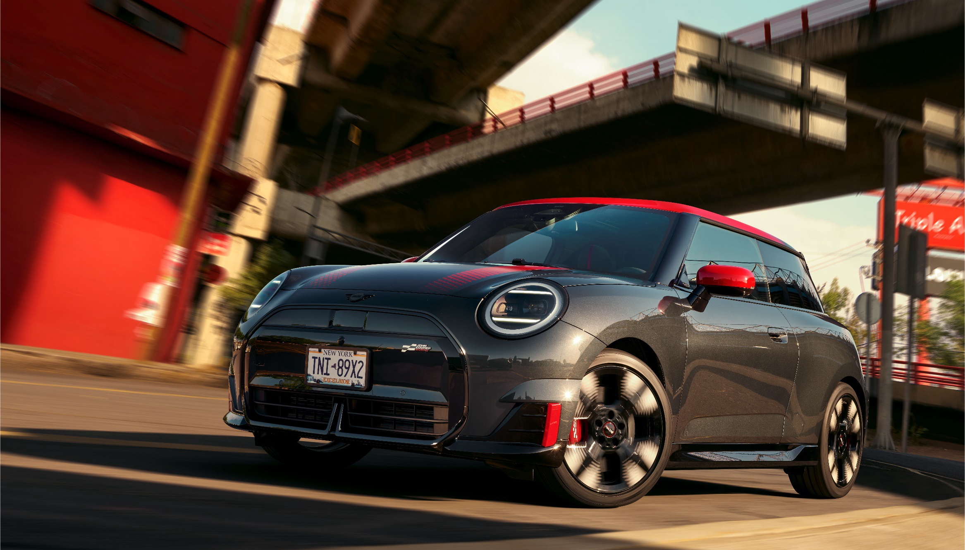
MINI GLOBAL RESULTS
Notes:
BMW BEV growth against global trend to strengthen global sales performance.

Slide 10
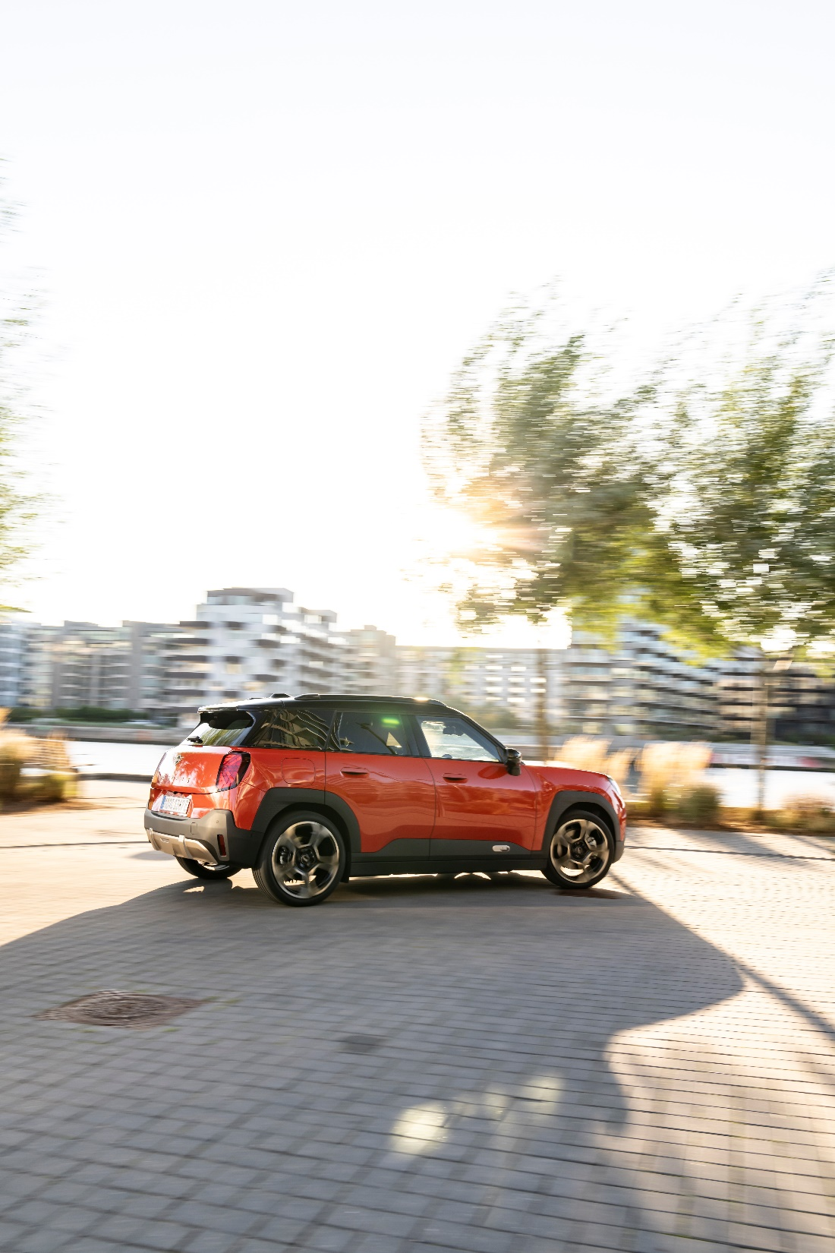
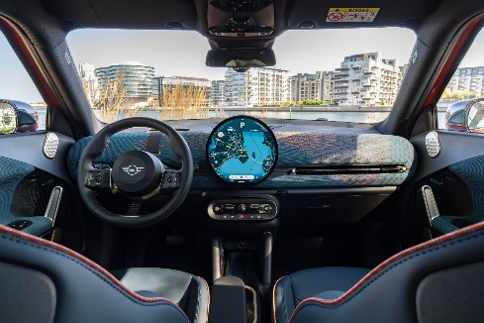
MINI GLOBAL RESULTS
-17.1%
244 915
Total Sales
BEV models sold almost doubled in 2024/Q4, 29,698 electric MINI’s delivered.
2024 – year of the complete brand renewal.
Electric offerings in every segment.
2025 - MINI Cabrio, JCW versions, including first JCW electric models.
Major UX update with the first OLED round screen in automotive industry.
Notes:
Complete model range transformation, supported by electrification and new technologies, such as an UX with first OLED round screen in automotive industry.

Slide 11
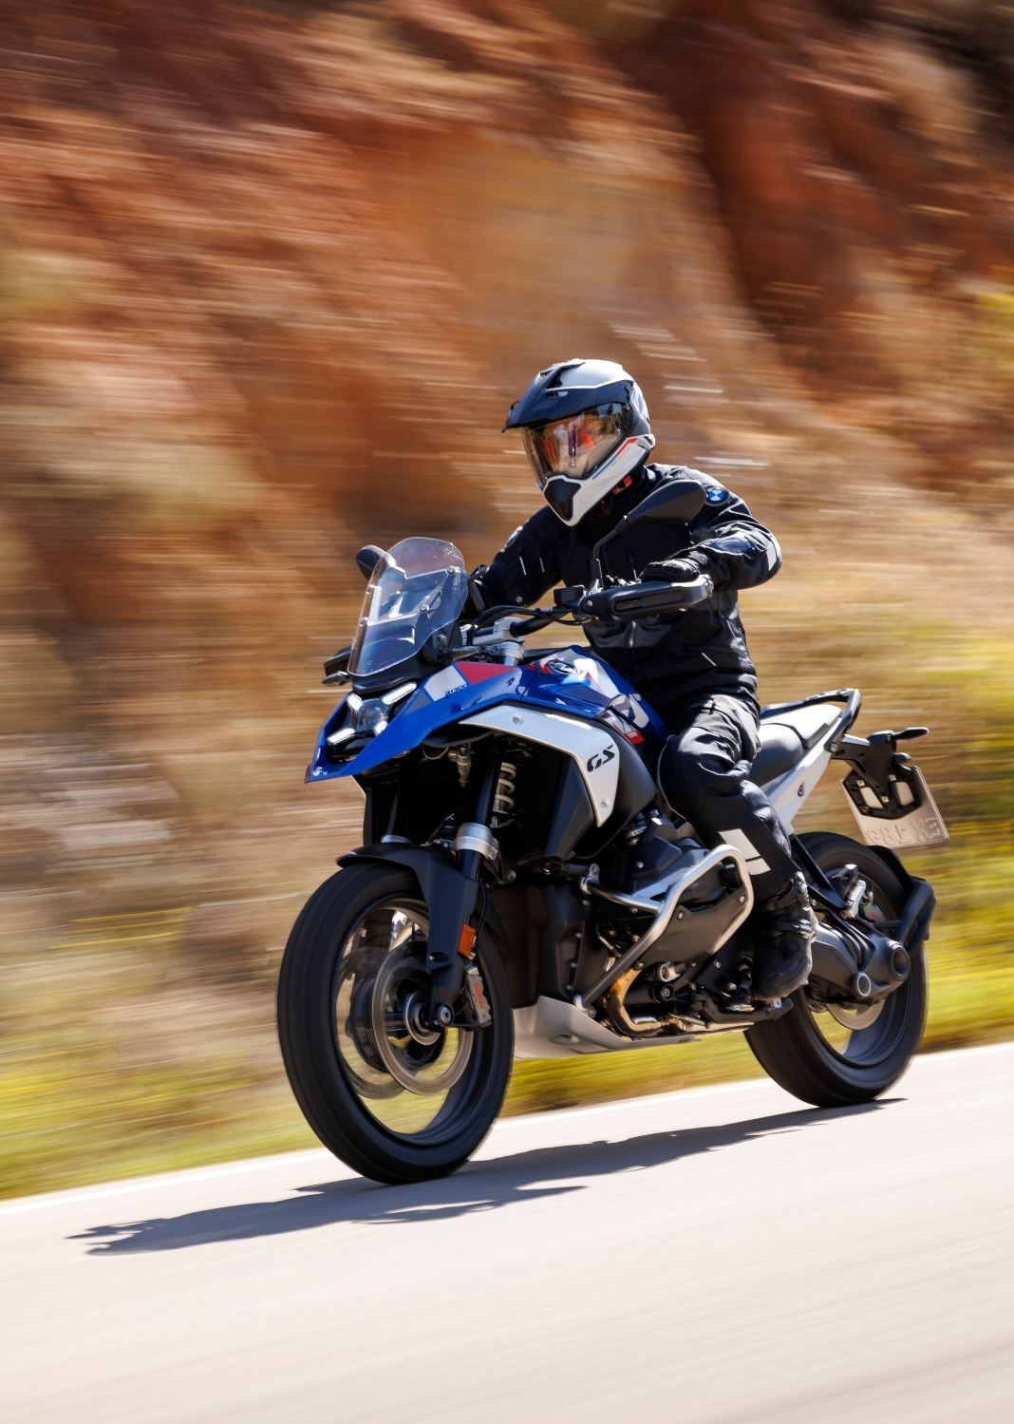
BMW MOTORRAD
GLOBAL RESULTS 2024
+0.6%
210 408
RECORD YEAR
Sales records in most regions.
Successful introduction of the new R 1300 GS and R 1300 GS Adventure model range.
Notes:
Also BMW Motorrad had a record year in 2024.
Our backbone, like in Romania, is the R1300GS/R1300GS Adventure.

Slide 12
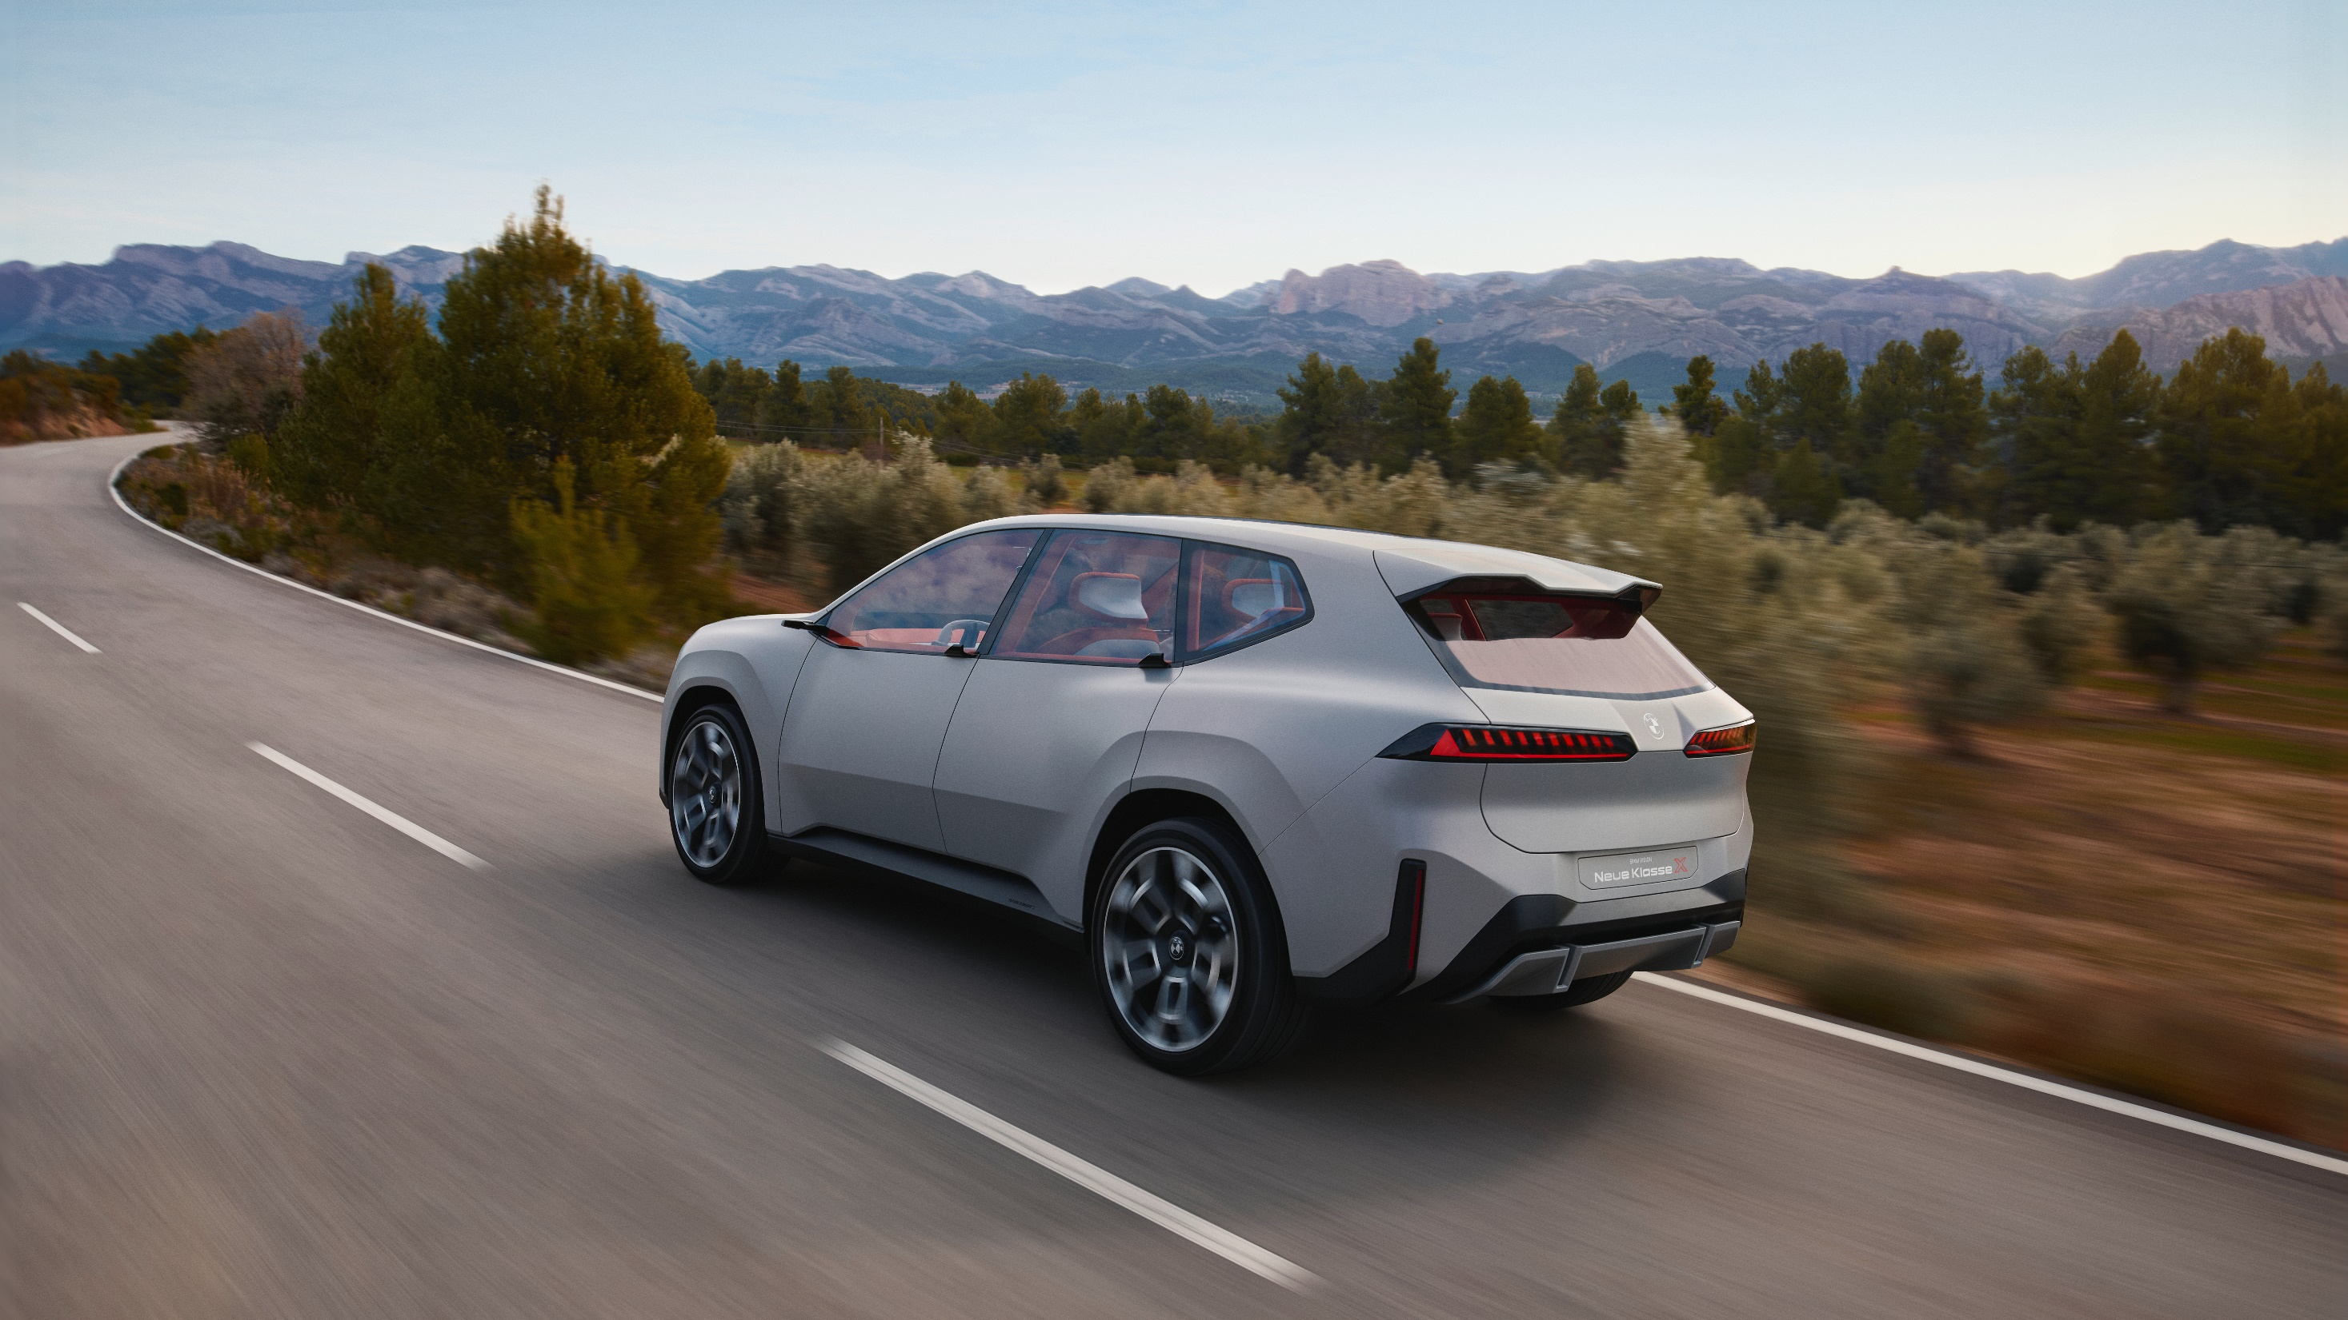
BMW GROUP BEV RESULTS 2024
+13.5%
+74.1%
+107.9%
+133.7%
BEST SELLERS
BMW i4
BMW iX1
BMW i5
MINI COOPER E / SE
Notes:
BMW Group strong BEV increase against market trends.
Consequent electrification in all segments.

Slide 13
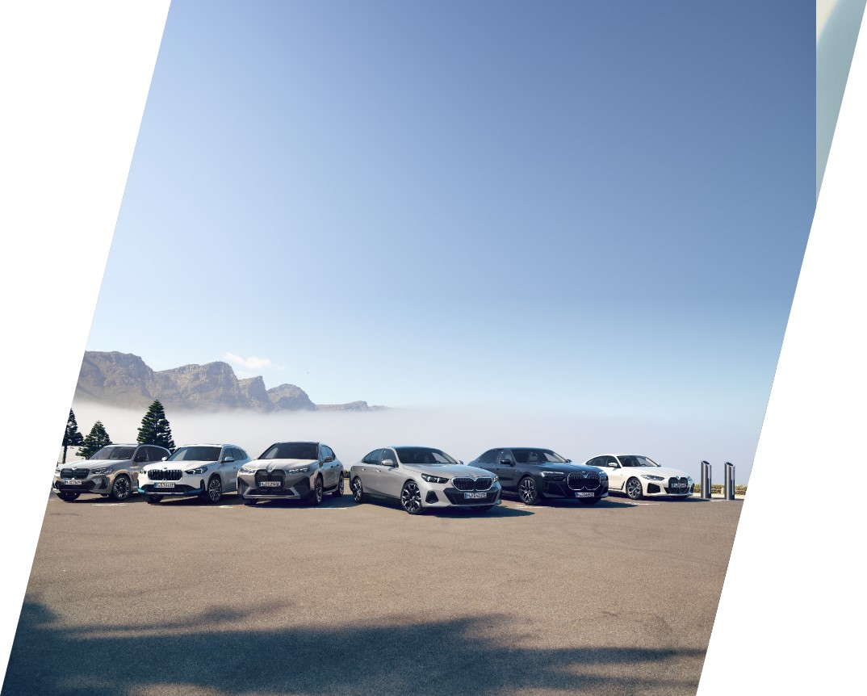
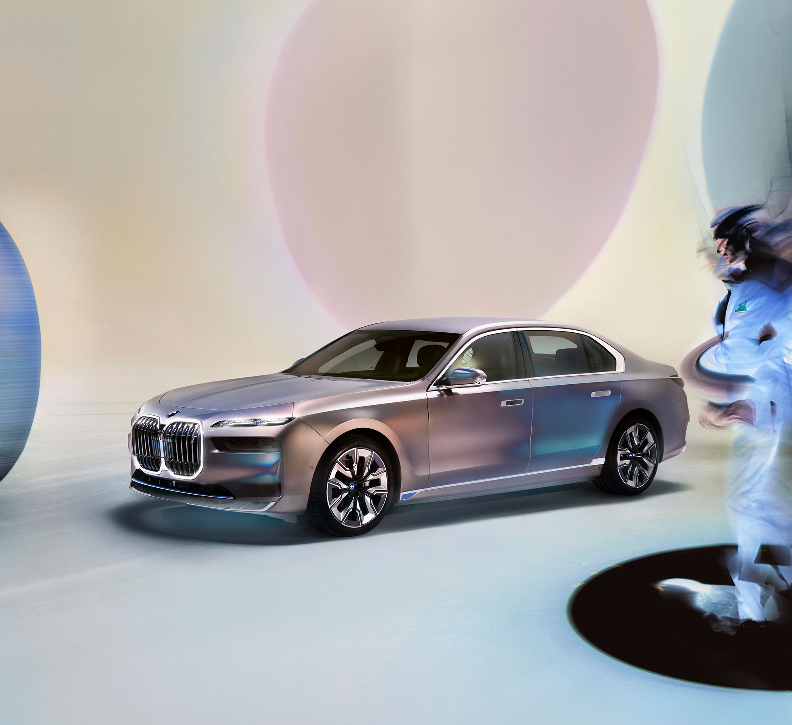
ELECTRIFICATION
AND SUSTAINABILITY
since
Pioneer
2013.
We increased sales of all-electric cars (BEVs) in 2024 (+13.5%).
We achieved 17.4% all-electric cars as proportion of our total sales in 2024.
By 2030 we expect BEVs will account for >50% of global sales and will be available for 100% of today’s
market segments.
Notes:
In the first 9 months, BMV was the 3rd brand in EV automobile sales and the first legacy OEMs.
BMW number one premium electric brand in EV sales.

Slide 14
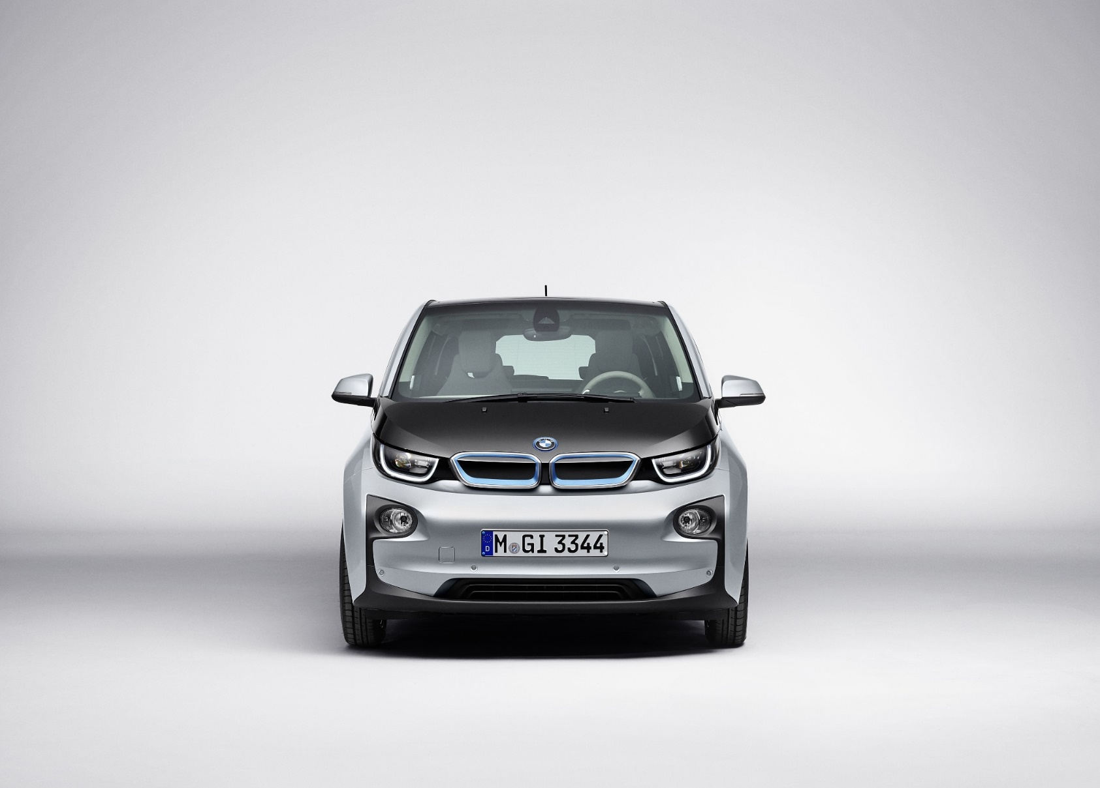
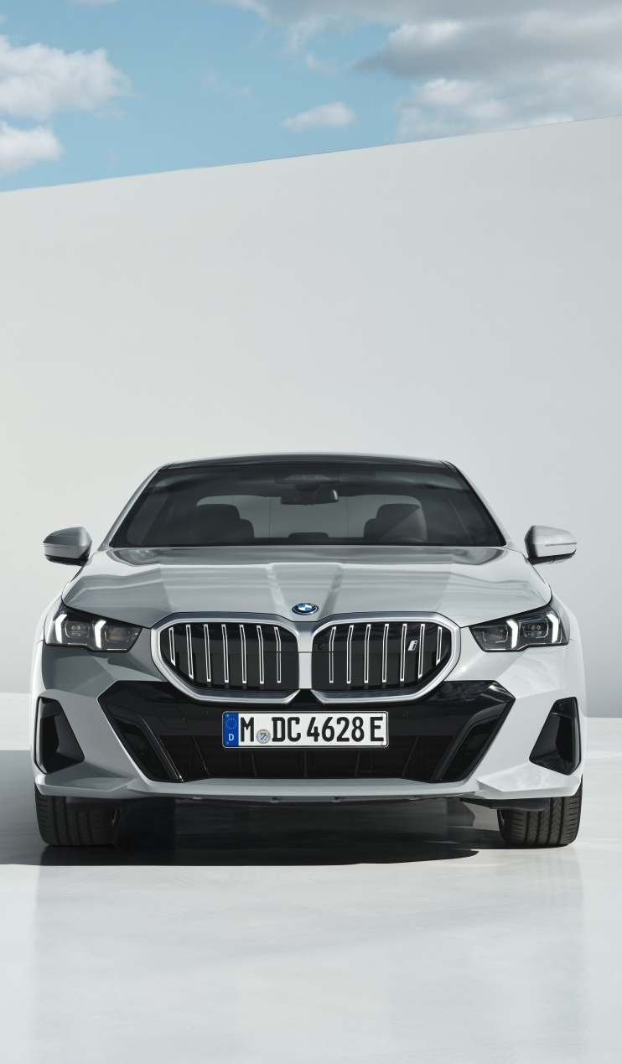

STRATEGIC TRANSFORMATION
2013
A pioneer in electric mobility.
2024
Electrification of the entire range.
2025
NEUE KLASSE: A revolution in technology, electrification and digitalization.

Slide 15
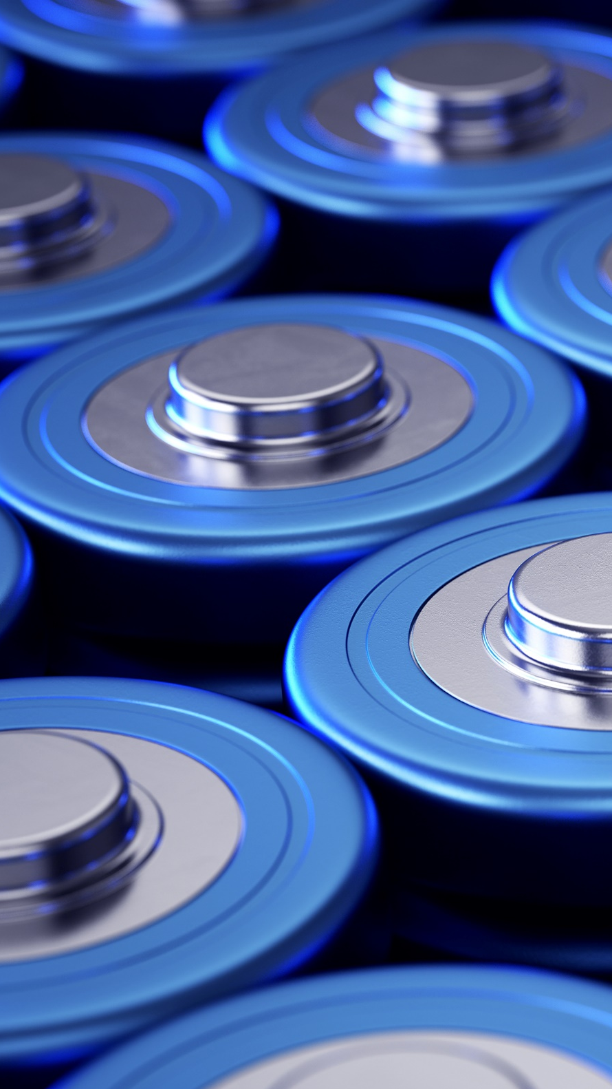
BATTERY COMPETENCE
USP NEUE KLASSE 2025
Introduction cylindrical battery cell design for our 6th generation coming in 2025 with Neue Klasse.
+30% range
-30% charging time
-40 to 50% cost on pack level and drivetrain*
Production of battery cells with 100% electricity from renewable sources.
Ability to recover >90% of the high-voltage storage systems raw material.
* Estimate based on comparable e-range and scope of components compared to the current Gen5 eDrive System comprising of the high-voltage battery pack and the electric drivetrain.
All numbers refer to base year 2019.
Notes:
BMW Group has developed strong competence in battery technology and unique expertise of the technology.
We have unique competence centers for battery cell development, battery cell production and recycling.
We are already recycling battery cells in China and moving forward to do the same in Europe and USA, coming closer to circular economy and significantly reducing CO2 emissions. For example, for the BMW i5, using secondary materials and green energy in battery cell production, we reduce by 10% the CO2 footprint for the complete model lifecycle.

Slide 16
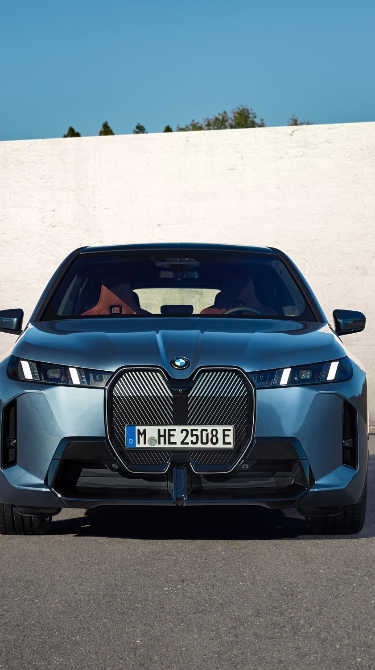
SUSTAINABILITY OVERVIEW
Sustainablity beyond electrification: circular economy and total vehicle footprint.
We are aiming to reduce our overall CO₂ footprint per vehicle by 40% across the entire value chain by 2030 (vs. 2019 levels).
Approximately 39% of the total variable target remuneration of the Board members is linked to ESG targets.
Notes:
Sustainability goes significantly beyond electrification and driving emissions.
BMW Group has clear and transparent targets for 2030 for the complete vehicle footprint.
BMW Group was the first automotive company with an environmental officer already in the 1970’, and was also the fist company to have clear bonus targets for the management -> 39% of the total variable target for the board members in linked to ESG targets.

Slide 17
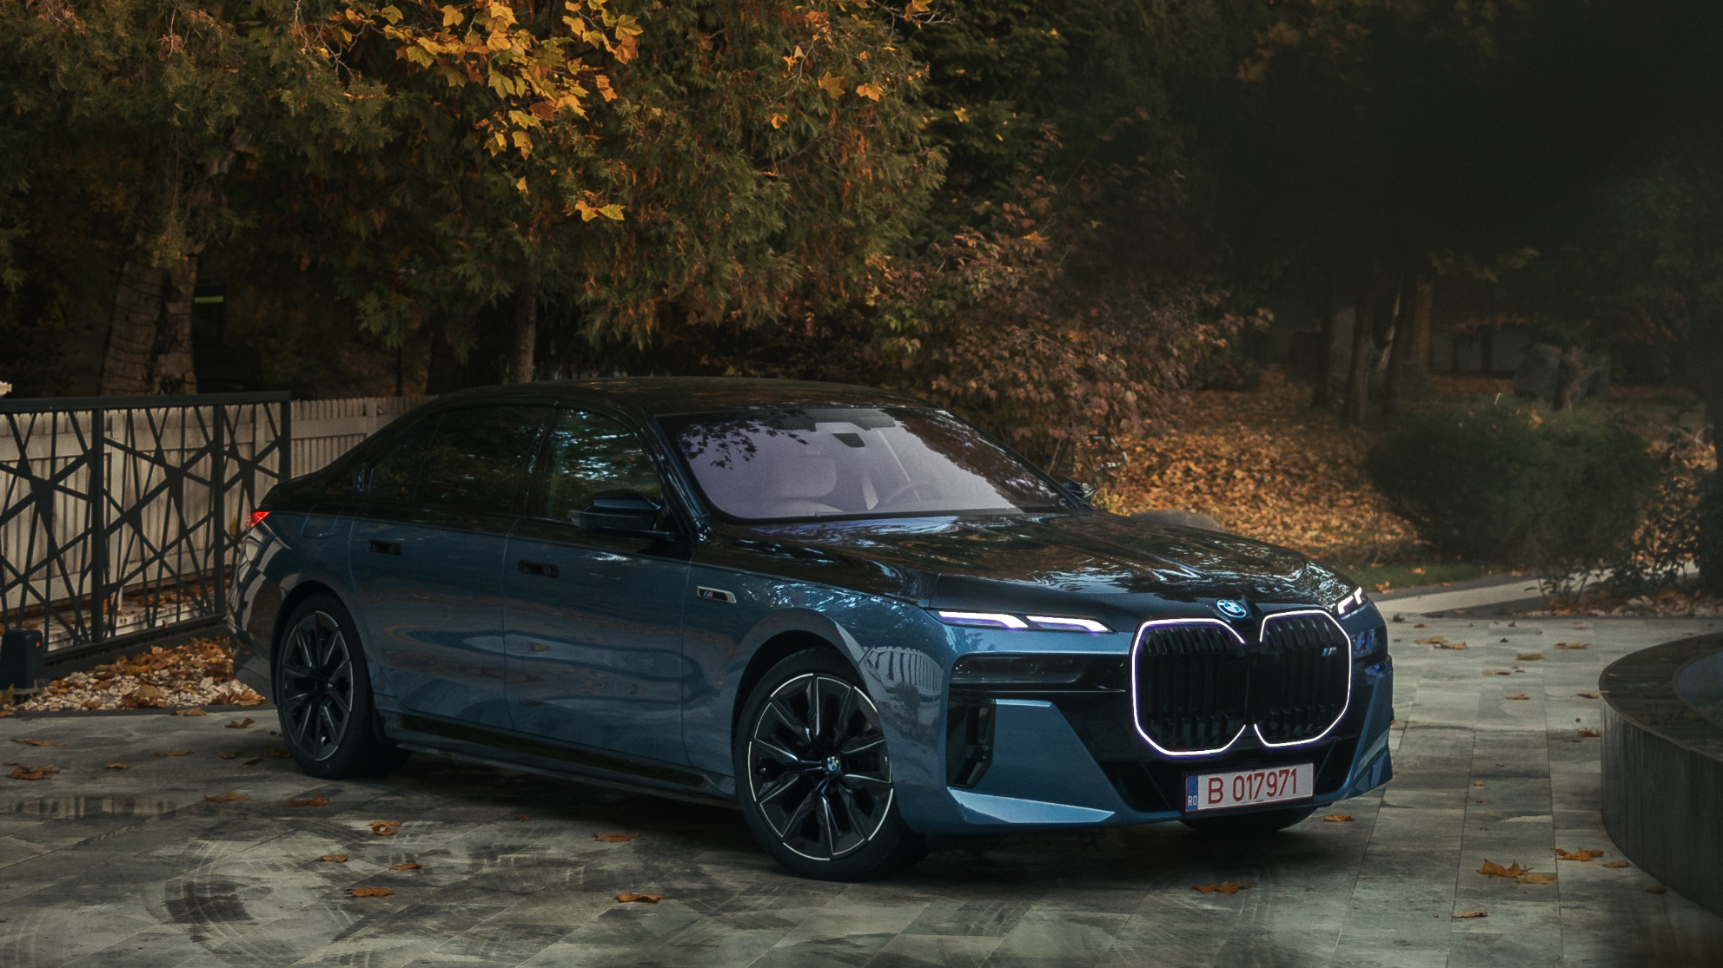
BMW GROUP ROMANIA
THEN AND NOW

Slide 18
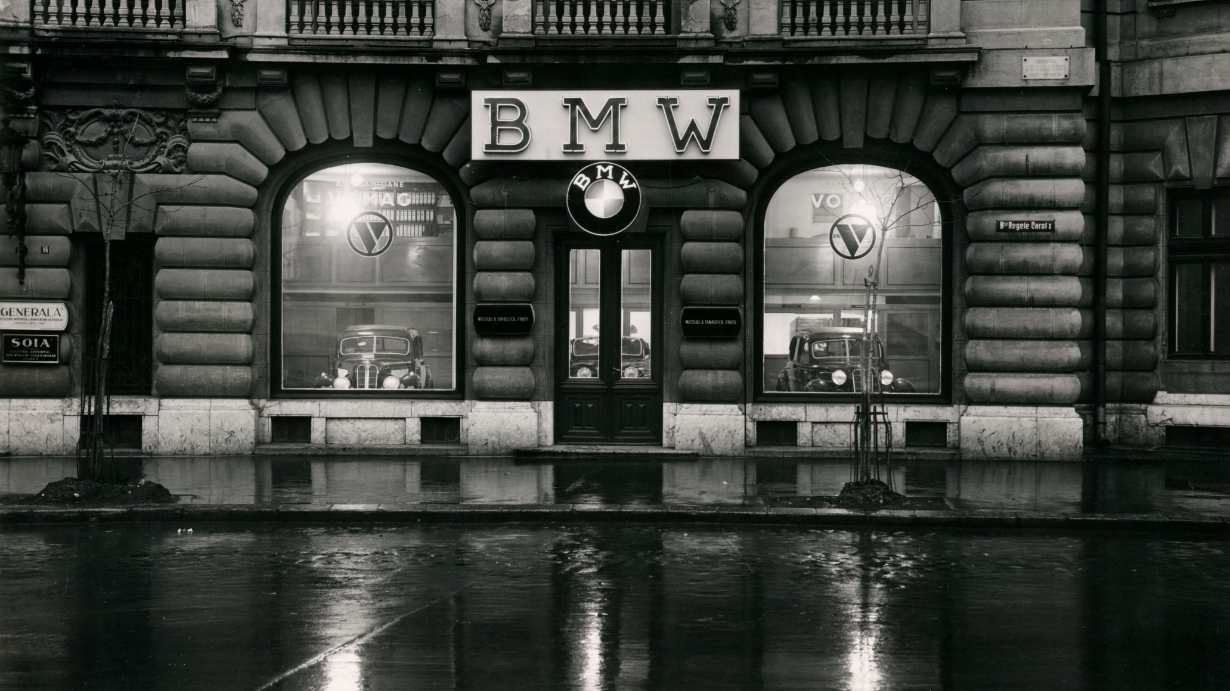
BMW ROMANIA THEN

Slide 19
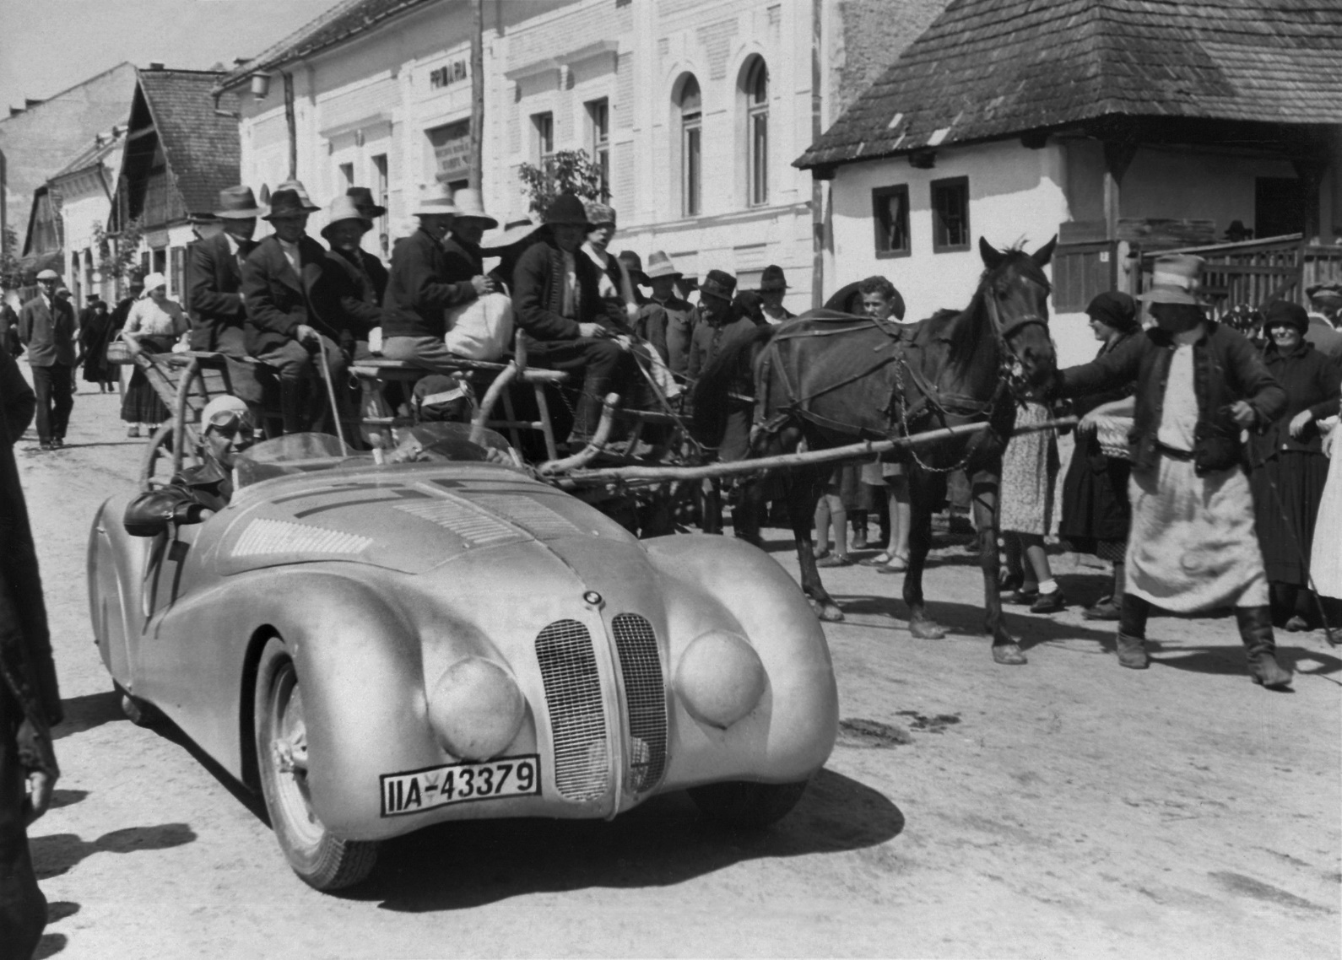
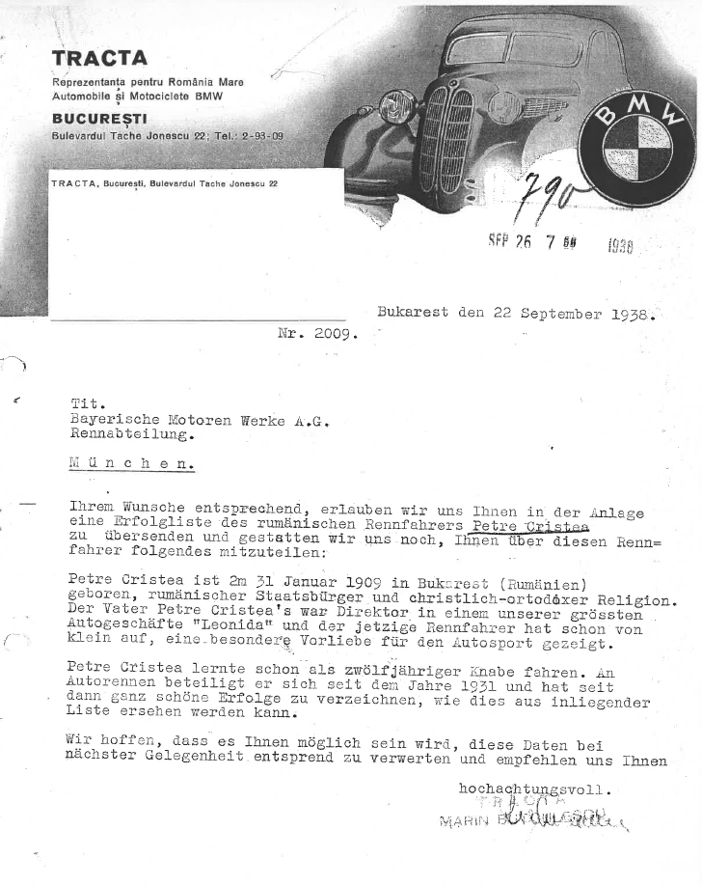
The last major competition that the BMW 328 MM Roadsters where entered was Braşov and Bucharest Grand Prix.
Notes:
The letter showed here is address by the Tracta BMW representative towards BMW, at BMW request, giving details about the racing performance of Petre Cristea. It is a clear sign that Cristea was monitored by BMW. Based on that, some speculate that he could have become a BMW works driver.
The last major competition of the famous BMW 328 Mille Miglia Roadsters was in Romania. The cars were entered in the Brasov and Bucharest Grand Prix. They attended the practice in Brasov, but never raced. The official BMW race team needed to make a hasty return to Munich due to the outbreak of the War.

Slide 20
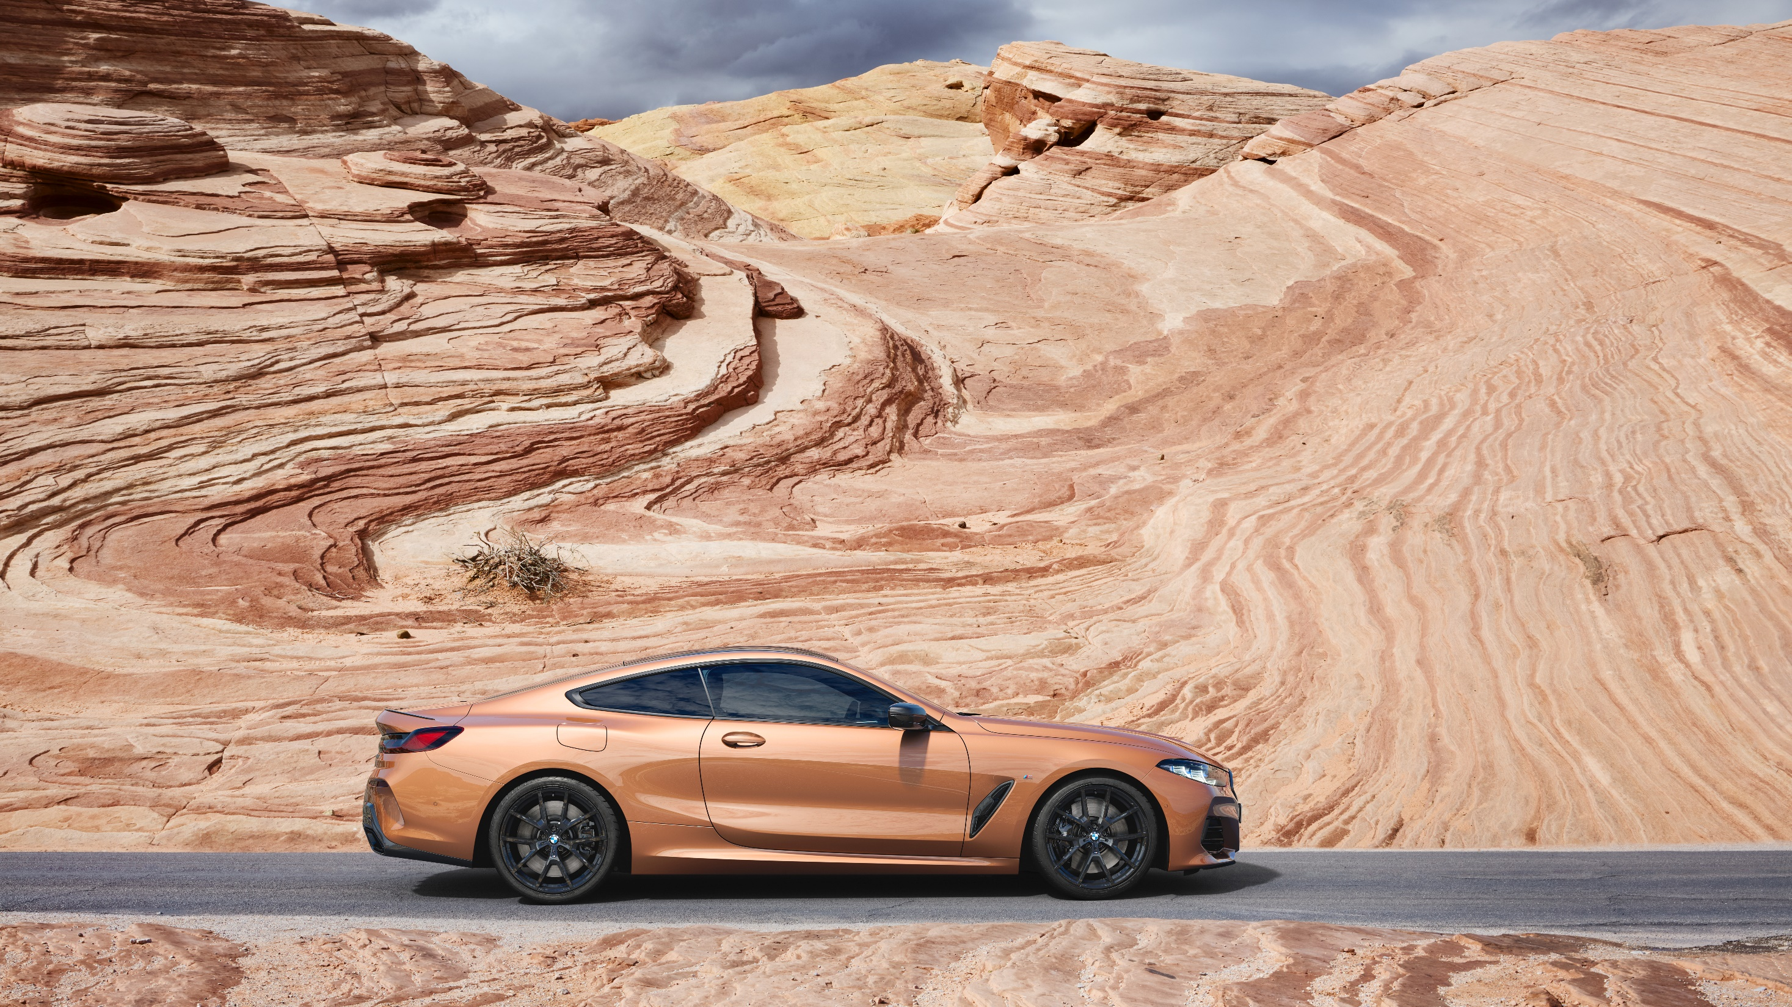
BMW IN ROMANIA.
RESULTS 2024.
Notes:
Romania has delivered one of the best performances in the region with record sales in all our strategic segments:
BEV, M and Luxury segments.
We are the only market in the region that managed such a strong performance.
We have also record BMW Group Romania registrations for car, motorcycles and BMW.
Market performance gives us the resources and opportunities to invest in the future.

Slide 21
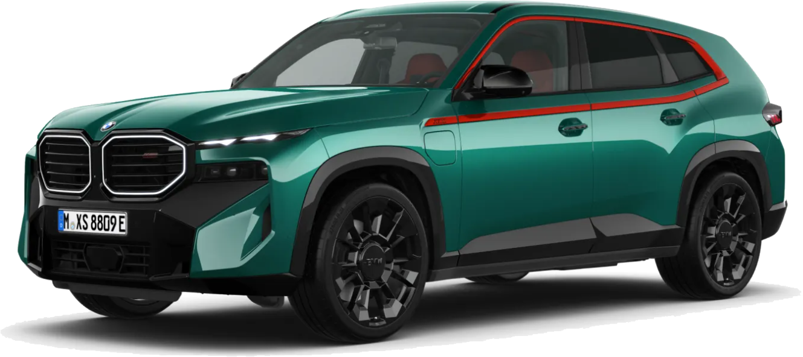
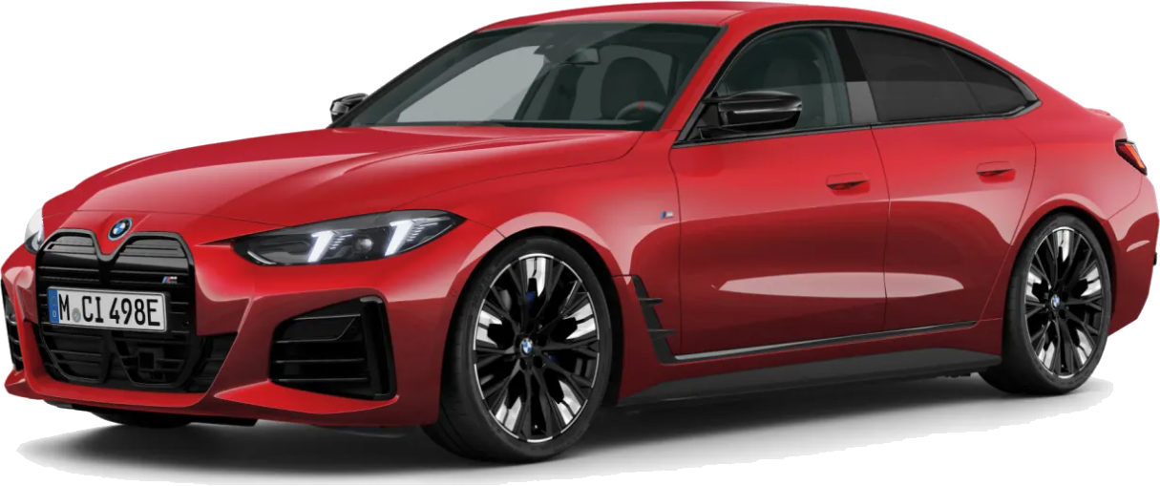
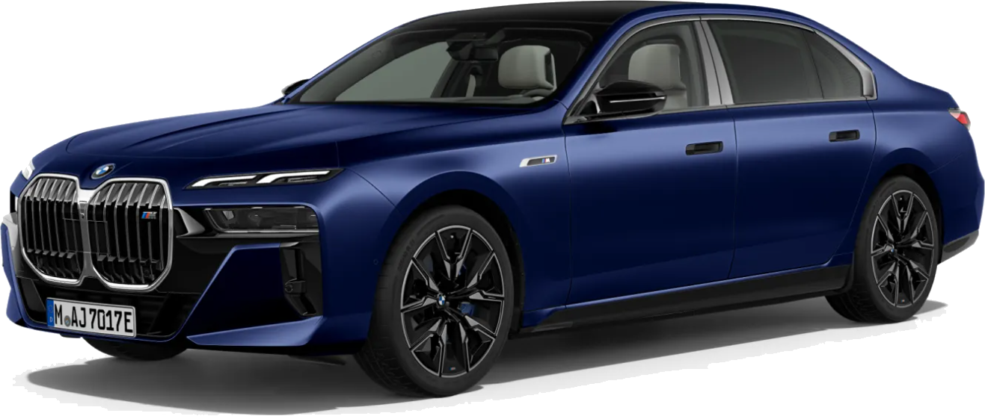
BMW GROUP ROMANIA 2024 RECORD YEAR
5.222 BMW & MINI @ +2.9%
BMW BEV - RECORD YEAR
BMW i4: +17%
BMW M - RECORD YEAR
BMW XM: +62%
LUXURY SEGMENT - RECORD YEAR
BMW 7 SERIES: +41%
Notes:
Romania has delivered one of the best performances in the region with record sales in all our strategic segments:
BEV, M and Luxury segments.
We are the only market in the region that managed such a strong performance.
We have also record BMW Group Romania registrations for car, motorcycles and BMW.
Market performance gives us the resources and opportunities to invest in the future.

Slide 22
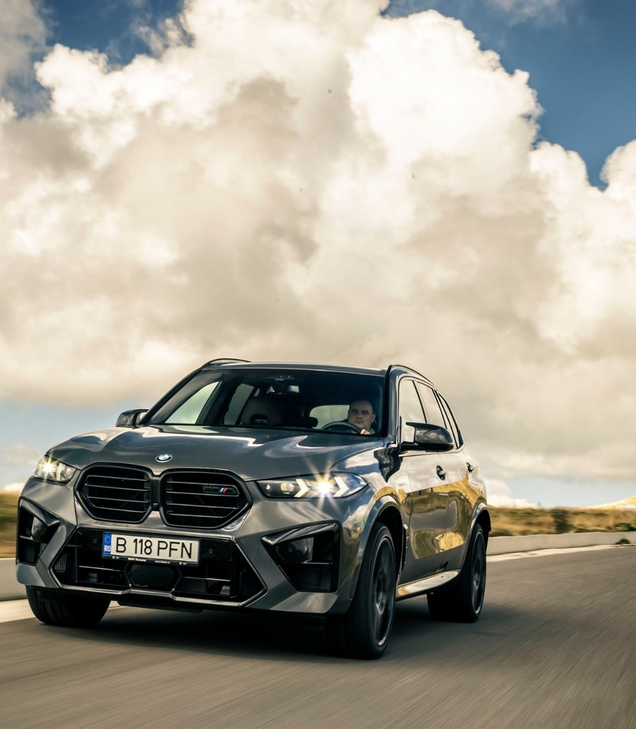
BMW 2024 +4.4%
Overall performance:
4.895 registrations (+4.4%).
Number one brand in premium automobile segment.
BEST SELLERS
 | Total | % Deviation vs. PY
BMW X5 | 664 | -19%
BMW X1 | 613 | +103%
BMW 3 Series | 407 | -36%
BMW X6 | 374 | +44%
BMW X3 | 321 | -18%
Notes:
Record performance for BMW.
BMW X5 remains the best seller.
Very strong performance for BMW X1, exceptionally well received on the market.
We are a BMW X and BMW xDrive market, we are happy that BMW 3 Series has a stable and strong position in costumer preferences.

Slide 23
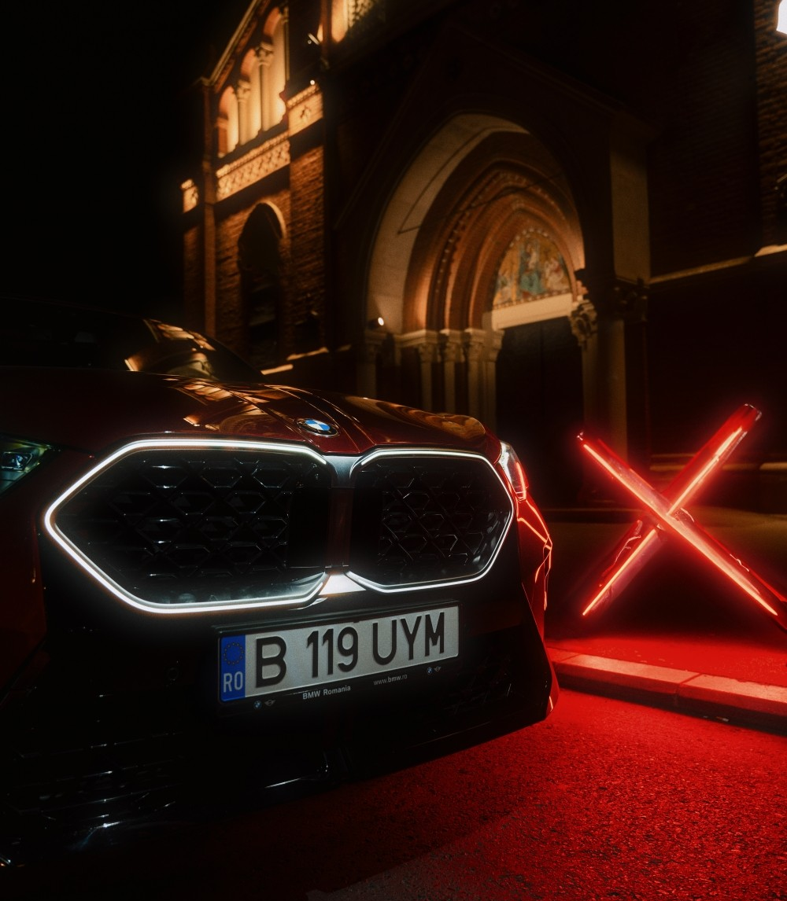
BMW xDrive and Engine Mix
xDrive share
82% (vs. 84% in 2023)
Diesel share
35% (vs. 32% in 2023)
xEV
28% (vs. 25% in 2023)
BEV
9.3% (vs. 9.5% in 2023)
Notes:
More than 3 in 4 cars are xDrive models.
Small increase in diesel share, we are still capable to deliver expectational diesel cars, highly efficient and with very low CO2 emissions.
xEV and BEV remain on a positive trend, despite a negative market trend, with a stronger growth on PHEV.
The BMW Group has identified openness to different technologies as central to its strategic orientation. Technology
openness ensures different drive types are developed and used in parallel, so that mobility solutions can be specially
tailored to the different needs of different regions and individuals.
This strategy makes the company extremely flexible: in countries with a limited charging infrastructure, for instance,
a hydrogen or hybrid drive may be the better choice, while elsewhere the focus may be on battery-electric vehicles.
By keeping an open mind to multiple technologies, the BMW Group can better prepare for the different infrastructural
conditions around the world, but also for geopolitical challenges such as dependence on raw materials.

Slide 24
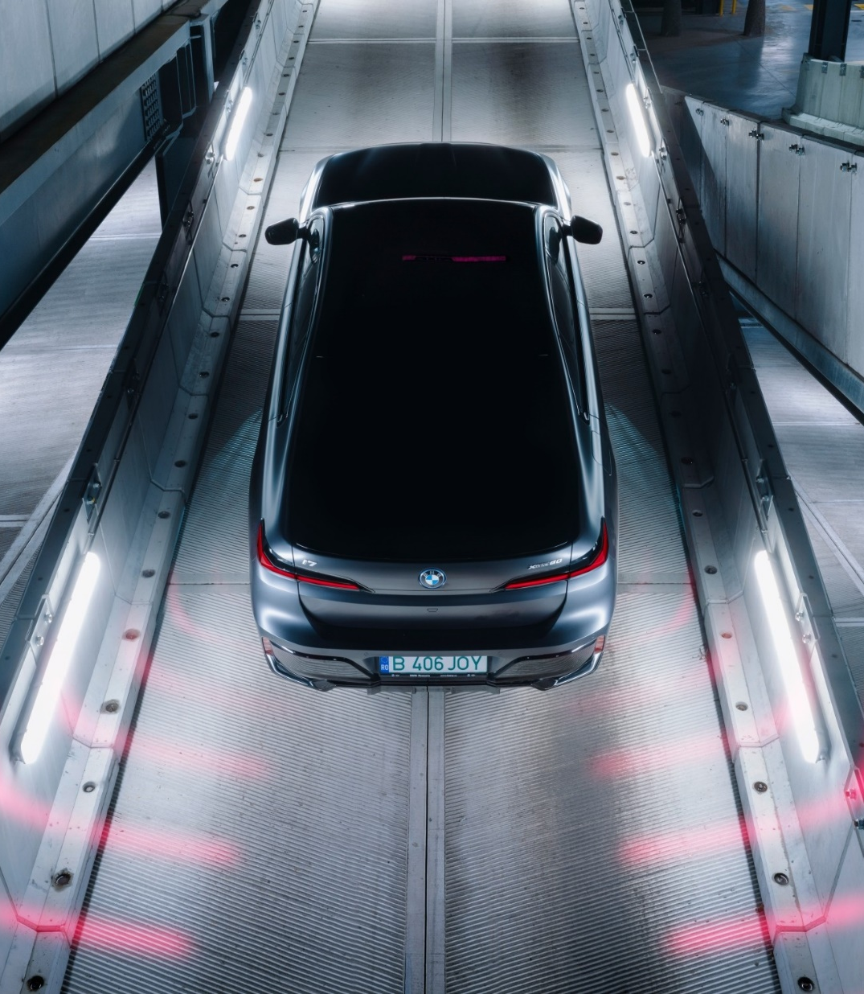
BMW xEV +17.4%
BEV – record year,
378 sales, +3.3%.
Best selling model: BMW i4 (150 units)
PHEV – record year,
764 sales, +26.3%.
Best selling model: BMW X1 (196 units)
and BMW X5 (195 units).
Notes:
Strong xEV performance driven by a diversified range.
New models, such as iX1/X1 PHEV and i7/ 7 PHEV are very well received also on the Romanian market, even in very competitive segments.

Slide 25
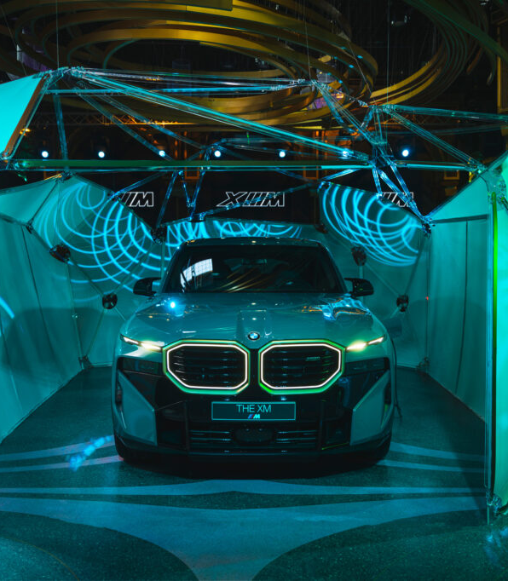
BMW M +37.6%
Overall performance: 684 unit, record year.
304 BMW M High Performance models (+32.2%).
380 BMW M Performance models (42.4%).
High Performance
 | Total
BMW XM | 41
BMW M3 | 40
BMW X6 M | 38
BMW M4 | 33
Total | 304
Performance
 | Total
M760e | 50
X5 M60i | 41
M440i | 35
X7 M60i | 28
Total | 380
Notes:
We have delivered another record performance with BMW.
We have a mature and a strong model offering.
XM – 41 units (including XM and XM label). But total XM sales (including 50eDrive entry level) – 91 units. Highly popular in Romania.
We have also strong order books for the new BMW M5.

Slide 26
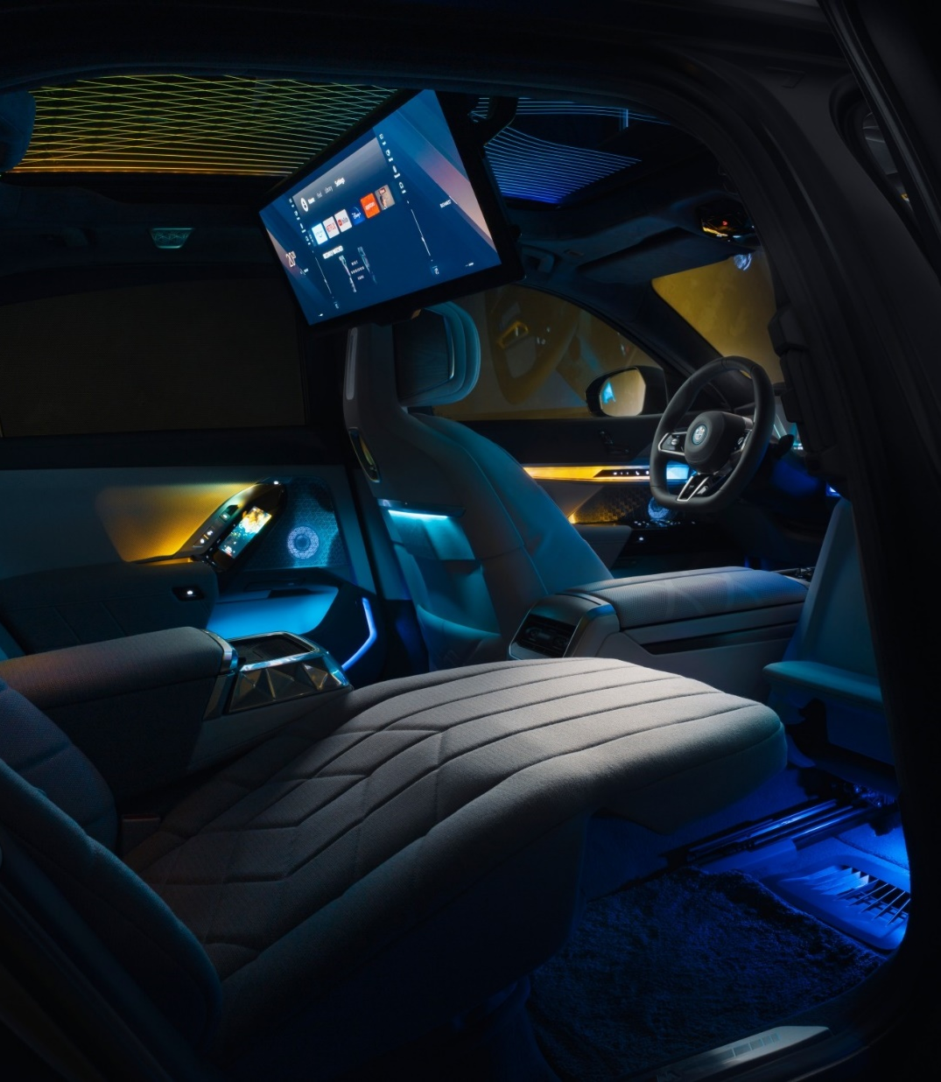
BMW Luxury Segment +29%
Record year for luxury segment models with the exception of BMW 8 Series that has reached end of production.
Luxury Segment Models
 | Total | % Deviation vs. PY
BMW 7 Series | 162 | +50%
BMW X7 | 160 | +7%
BMW XM | 91 | +62%
BMW 8 Series | 30 | -58%
Total | 443 | +29%
Notes:
Record year for the Luxury segment, with record performance for 7 Series, X7 and XM.

Slide 27
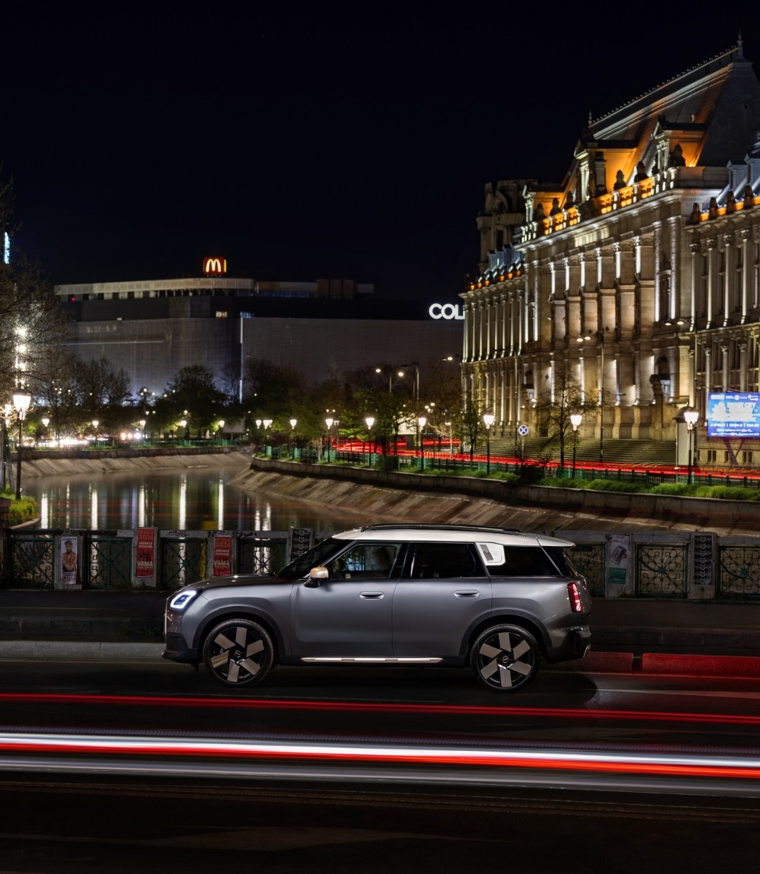
MINI –15.5%
Overall performance:
327 registrations (-15.5%).
2024 – year of the complete range renewal.
Strong pick-up in deliveries in Q4.
BEV: 72 units
JCW: 29 units
Notes:
MINI, due to a complete model range transformation, has seen a strong increase in Q4, after the complete model range renewal.
We will be able to offer a better picture of the brand performance in 2025, after full availability of the complete model range on the market.
A 3rd in the annual sales in Q4.

Slide 28
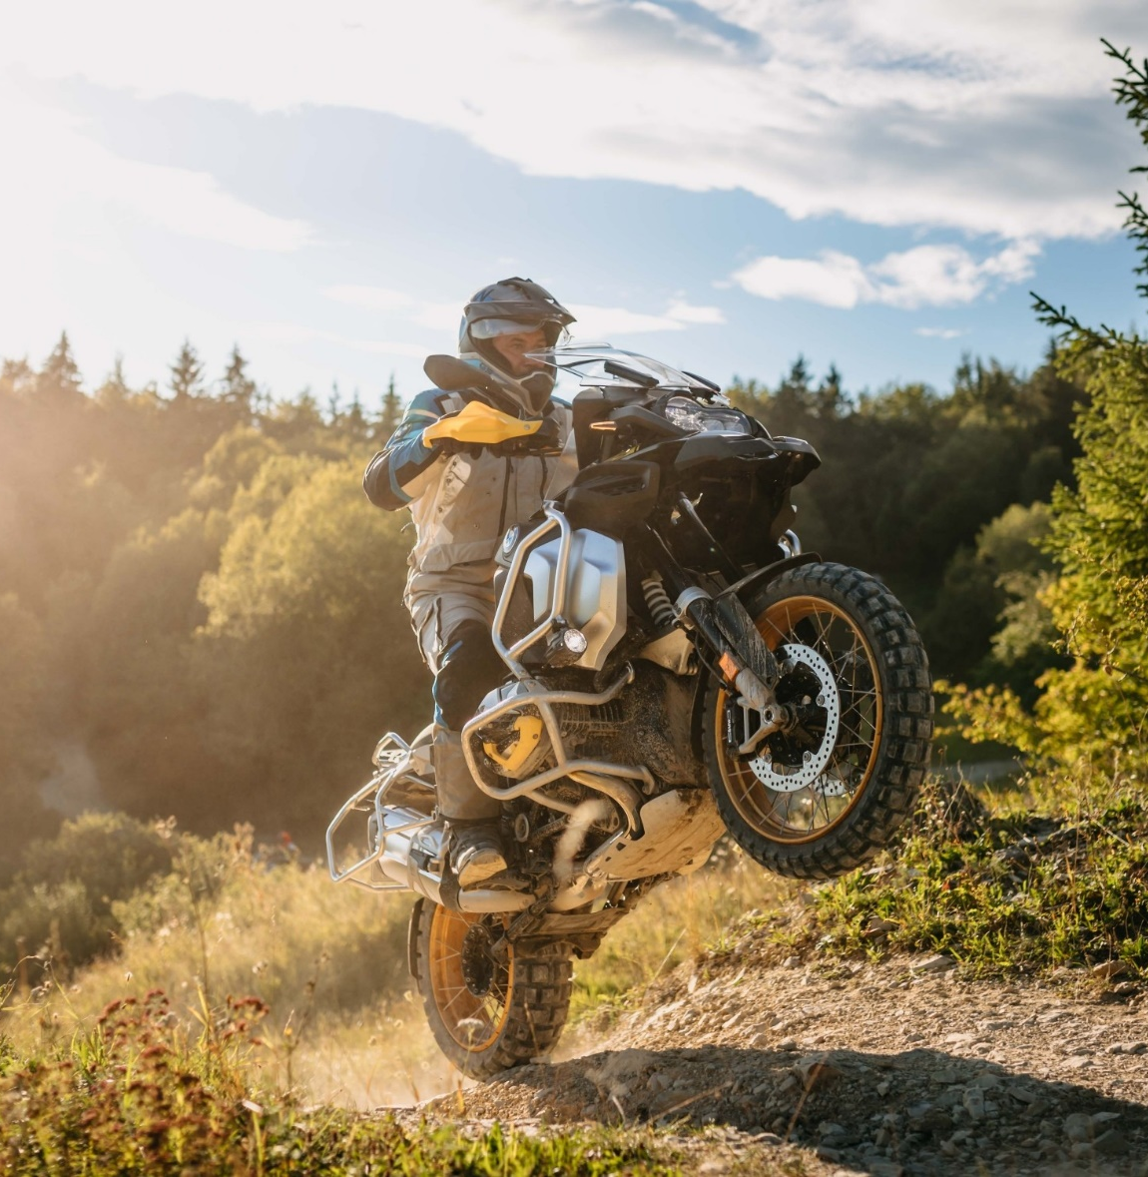
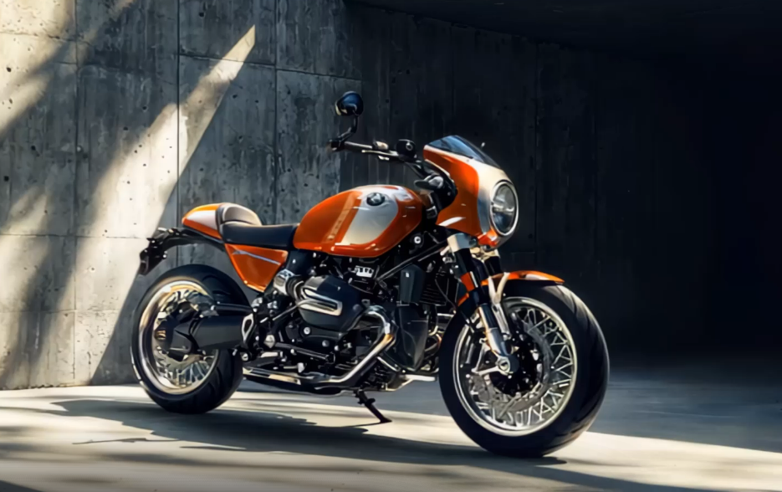
BMW Motorrad +13%
Record year: 830 (+13% growth).
Further growth perspectives in 2025 with the introduction of the new
R 1300 GS Adventure model.
Notes:
In the last 15 years we had continuous double digit growth.
We have continued the trend also in 2024.
Unique for our brand is an advanced level of financial services, on par with our leasing offering for automobiles.
This is strongly supporting sales and has led to 1 in 3 sold motorcycles to be leased in 2024.
Half of the financed motorcycles are via the Select high residual value program.

Slide 29
FINANCIAL SERVICES
2 in 5 cars delivered by BMW Group Romania are financed with BMW/MINI Financial Services products.
BMW/MINI Select or Operational Leasing products, at 25% from total financing contracts signed in 2024.

Slide 30
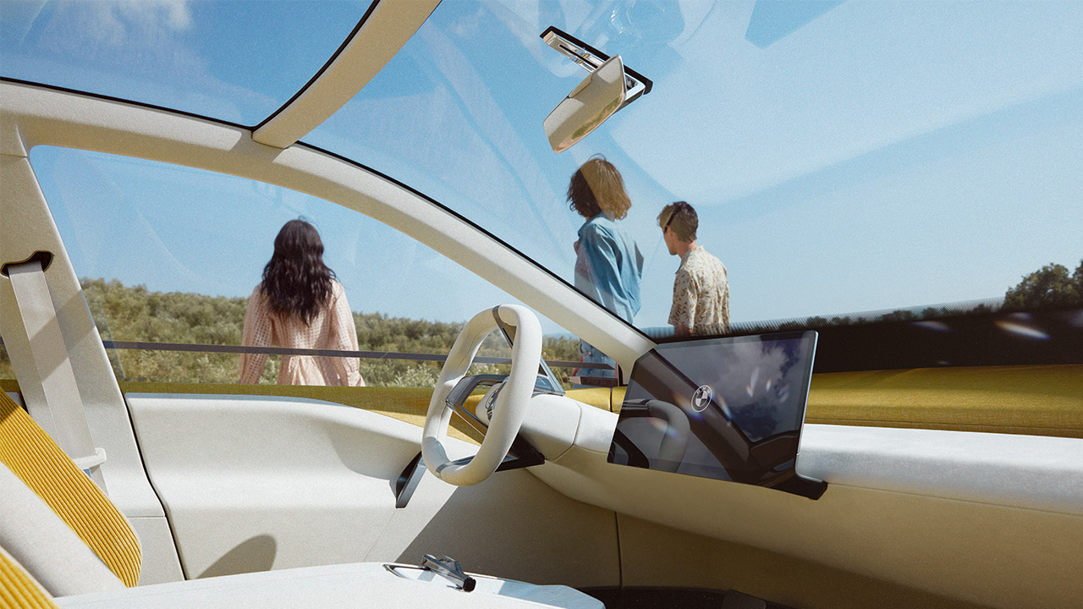
OUTLOOK 2025
Notes:
The New BMW iX was announced today and will be introduced together with the BMW 2 Series Gran Coupe in March this year.

Slide 31
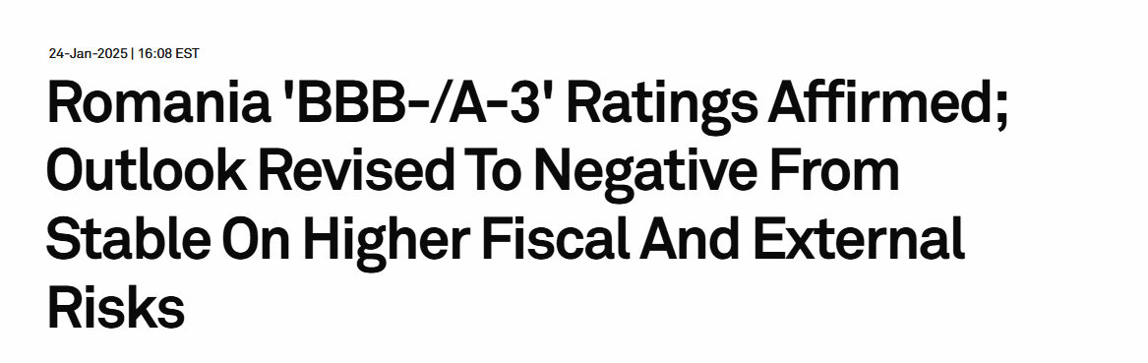
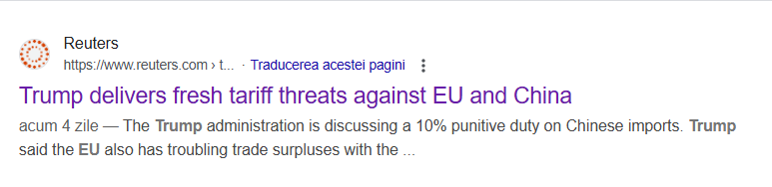
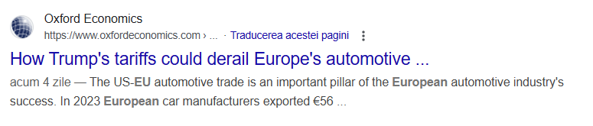
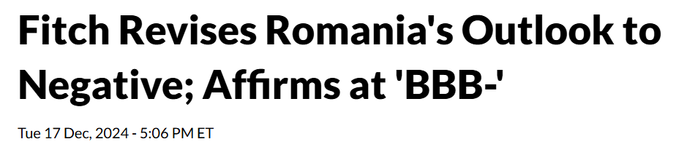
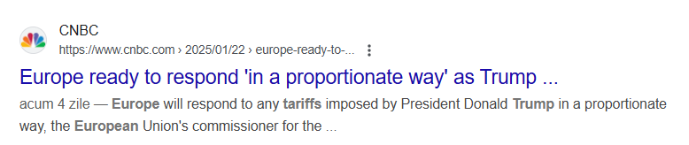
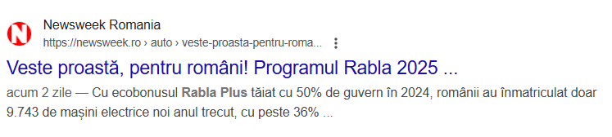
OUTLOOK 2025
GLOBAL AND LOCAL INSTABILITY
POLITICAL TRANSFORMATIONS
Notes:
We speak about records – but we look at 2025 with high caution.
There are several factors of high political instability:
The upcoming announced tariffs by the US Government. Here needs to be acknowledged that in the last years BMW was constantly the biggest car exporter from US in terms of value. Also, the synergies with the Mexico factory support the expanding of the supplier base in Spartanburg.
CO2 EU taxation scheme – We are on the path to respect the 2025 targets. BMW Group is one of the leaders of electrification, BMW was the 3rd brand in electric car sales in the first 9 months – something quite special for a legacy premium OEM! Still, we believe that the policy can be improved and we are looking for a dialogue in 2026, as the policy review is pllaned.
- The EU-China trade dispute.
- Elections in RO, DE of FR.

Slide 32
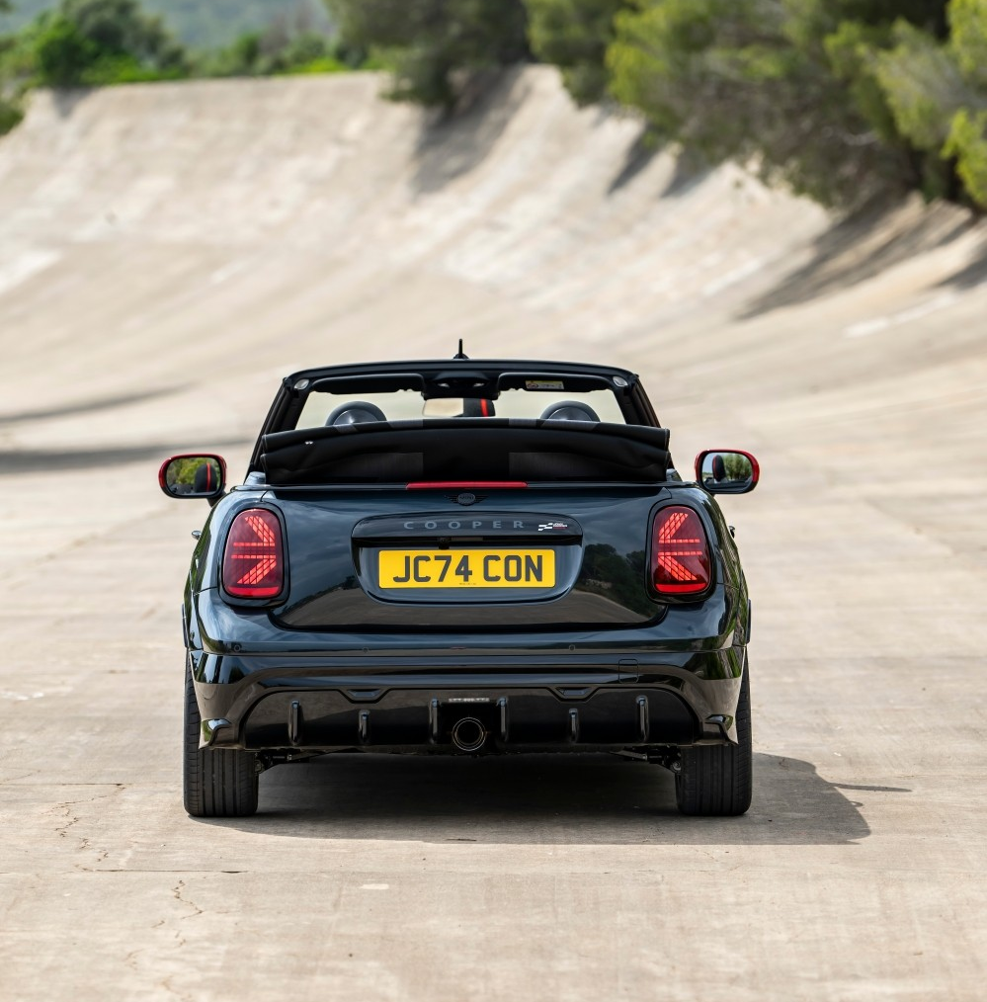
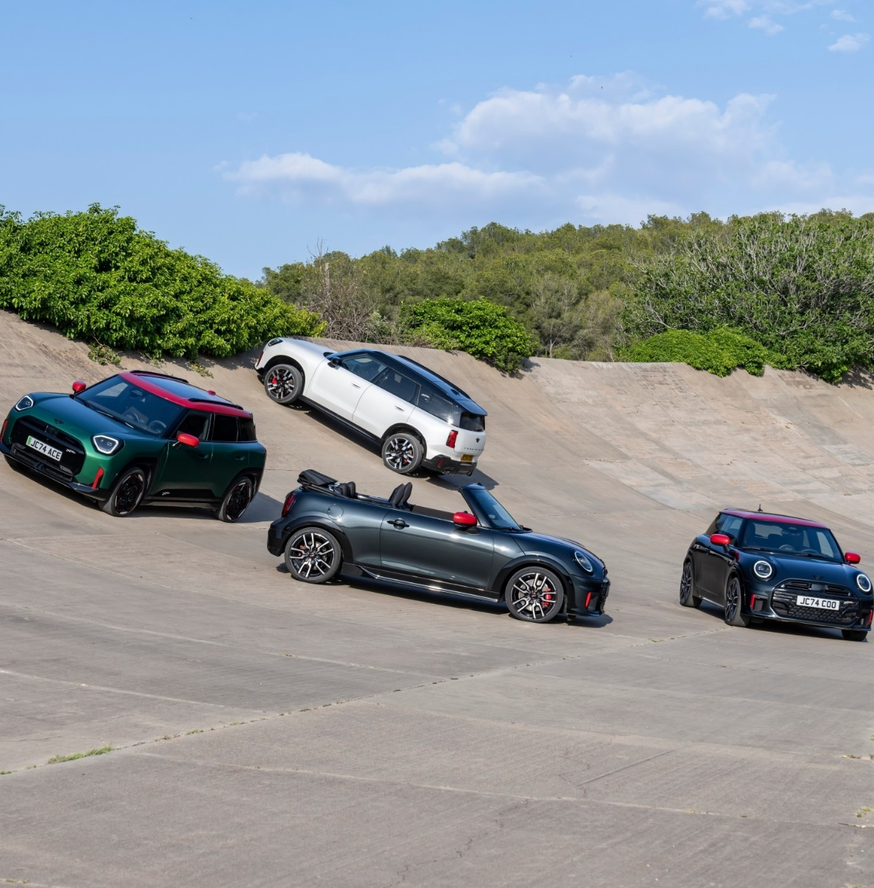
OUTLOOK 2025. MINI.
MINI Convertible
MINI Aceman JCW
2025 First quarter
2025 Spring
Notes:
With the MINI Convertible we will finish the complete renewal of the MINI brand.
With the introduction of the JCW models for MINI Aceman and Convertible, we will have 3 petrol and 2 electric JCW variants.

Slide 33
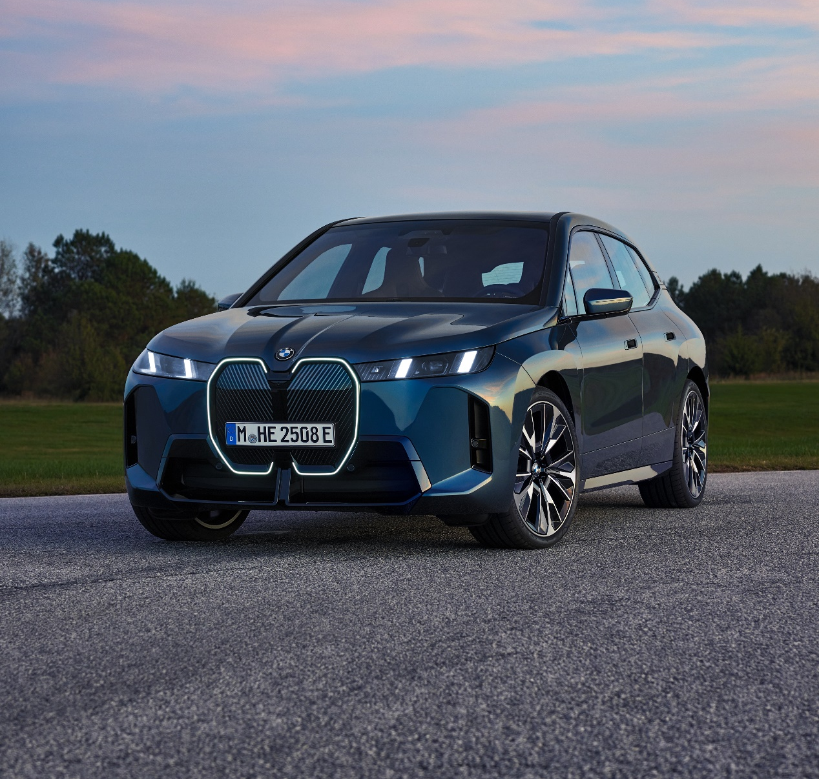
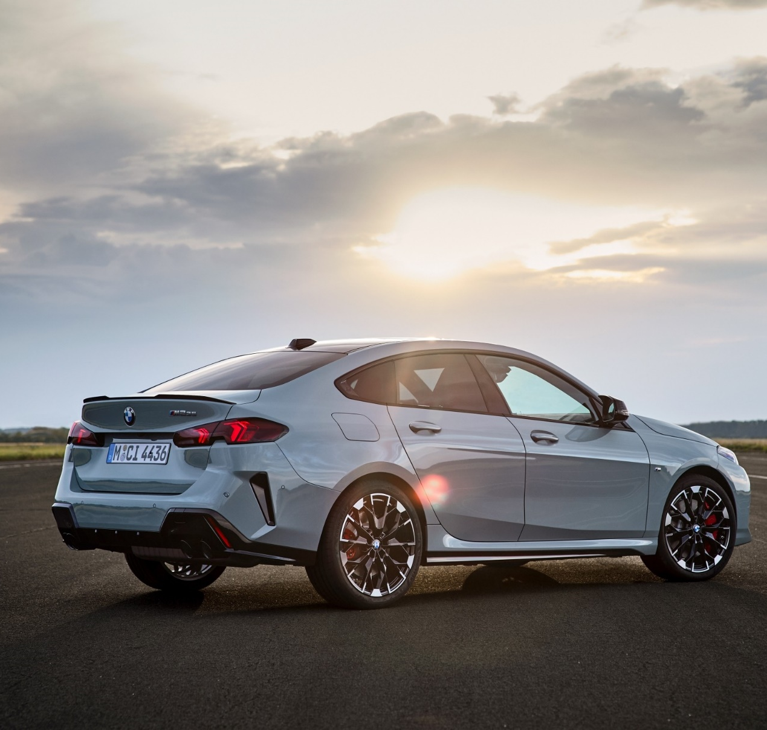
OUTLOOK 2025. BMW.
BMW iX
BMW 2 Series Gran Coupé
2025 March
2025 March
Notes:
The New BMW iX was announced today and will be introduced together with the BMW 2 Series Gran Coupe in March this year.

Slide 34
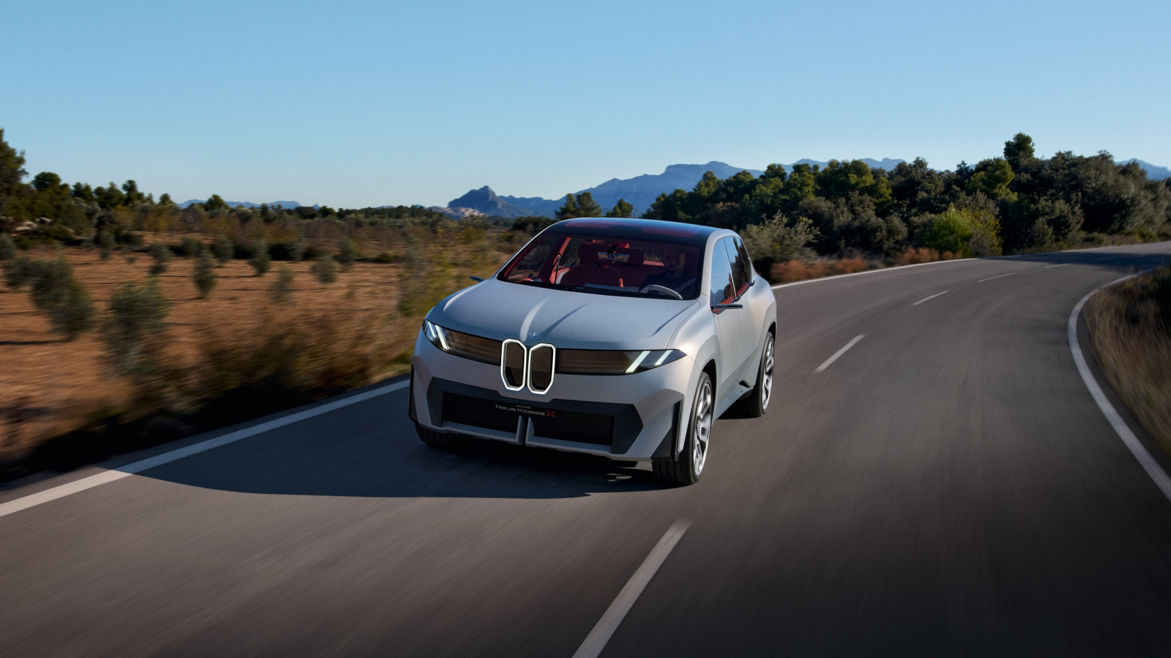
OUTLOOK 2025. NEUE KLASSE.
Vision Neue Klasse X
2025 Q4
Notes:
The series production model based on the Vision Neue Klasse X will be presented this autumn and will be produced at our new factory in Debrecen.
Neue Klasse is not a new model or a new technology, but a complete new philosophy that will transform the brand: from new production technologies, to new UI/UX solution.

Slide 35
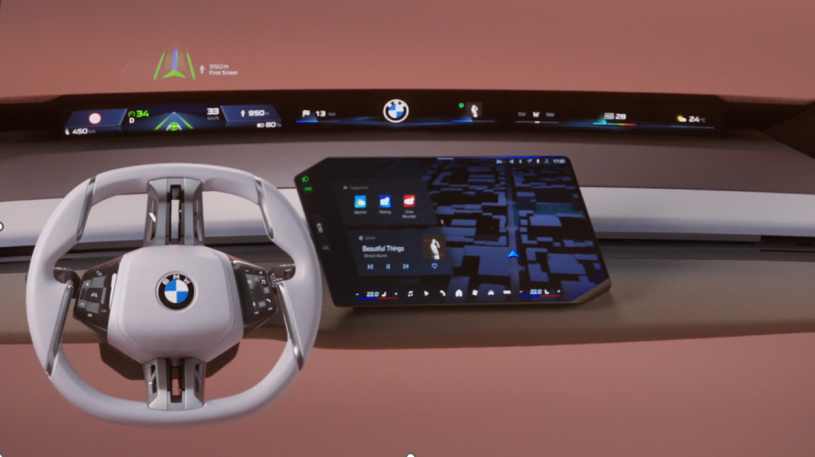
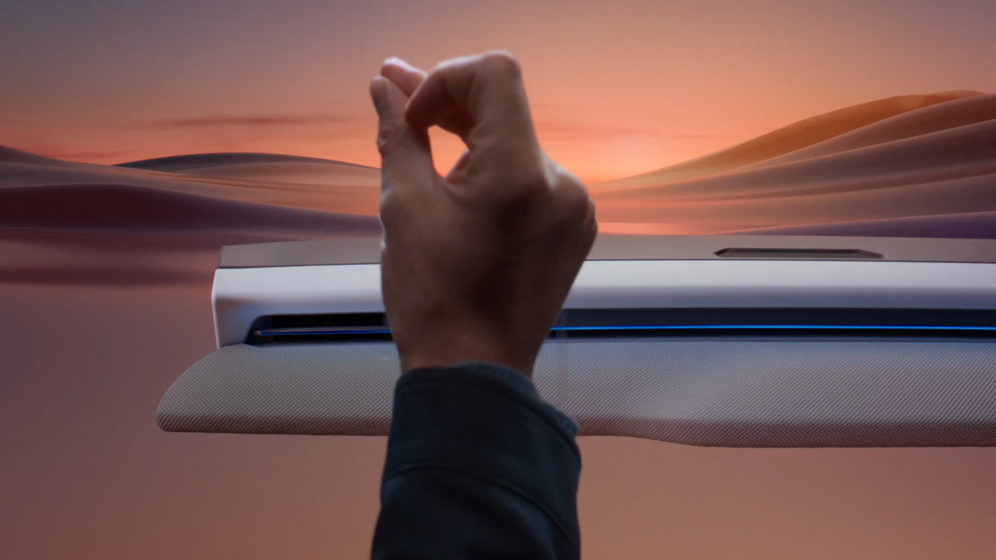
OUTLOOK 2025. NEUE KLASSE.
MORE THAN JUST A NEW CAR.
BMW Panoramic iDrive
BMW Panoramic Vision
BMW 3D Head-Up Display
Central display with new design.
New multifunction
steering wheel.
Notes:
The 10th generation of our iDrive system will be launched with our first Neue Klasse model, but will be used on all our future new models after that moment.

Slide 36
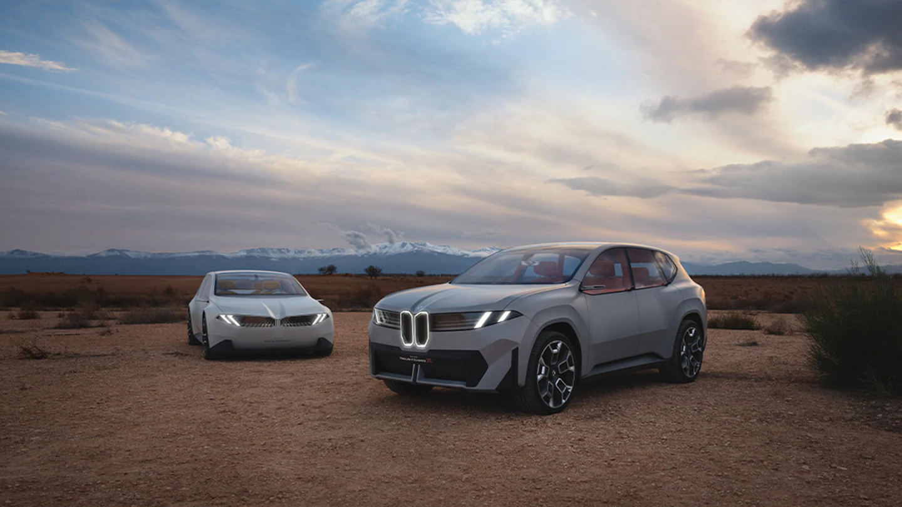
Thank YOU!

Slide 37
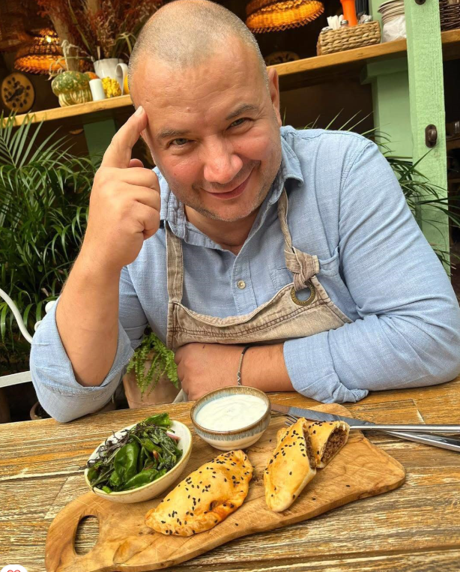
Marius Tudosiei
Băcănia Veche
Notes:
At BMW we are proud of our Romanian strong historical connection, our Romanian heritage.
And this is a place that is dedicated to the Romanian taste heritage.
We have prepared for you a cozy dinner, an opportunity to talk and build a dialogue in a friendly atmosphere.
Our host for tonight is the owner and the driving force behind this wonderful location – Marius.

